Slide 1
ALMA Data Reduction Result for HOPS171 (Band 6)
ALMA Summer School
2019.08.02
Group 1 (황어담)

Slide 2
Target Information
Isolated object
Bolometric temperature = 61.8K
Class 0/I star
Distance = 420pc

Slide 3
Observation
ALMA Band 6 (230 GHz)
Continuum and CO J=2-1 lines (C18O, 12CO, 13CO)
12m & 7m array
Maximum baseline ~ 335m
Synthesis beam size ~ 1’’
Primary beam size ~ 27’’
Velocity resolution ~ 20m/s
Mosaic observation

Slide 4
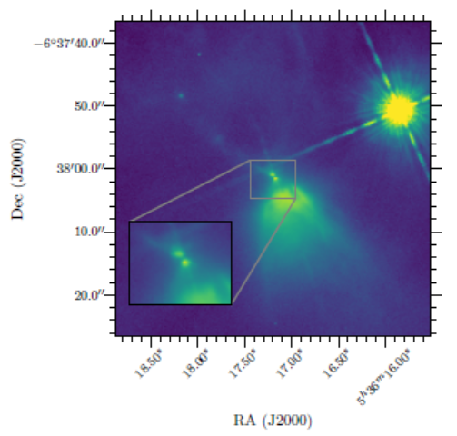
Source Image
Booker 2017
Spitzer MIPS in 24 μm
HST WFC3 F160W

Slide 5
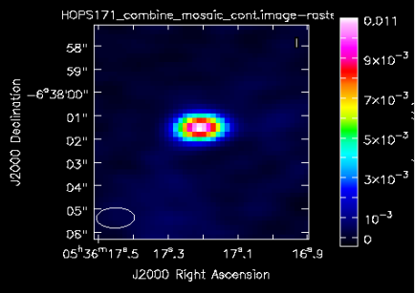
Continuum Map
RMS = 0.22mJy
Maximum = 11mJy
Flux = 11mJy
Can’t resolve disk

Slide 6
Disk Mass
Thi et al. 2001
$$M_{disk}≈0.033M_{⨀}$$

Slide 7
C18O
Systemic velocity = 8.3 km/s

Slide 8
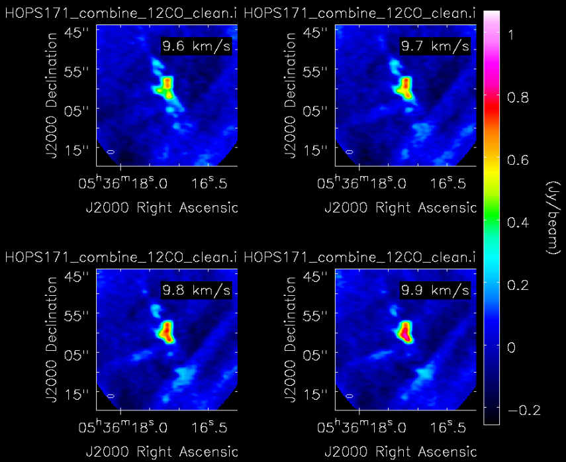
Channel Map (12CO)

Slide 9
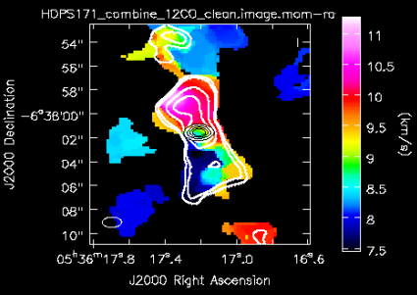
Moment Map (12CO)

Slide 10
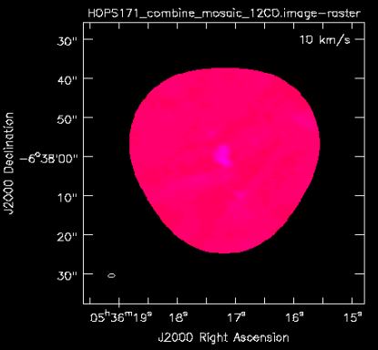
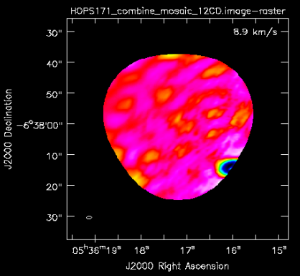
TCLEAN Problem

Slide 11
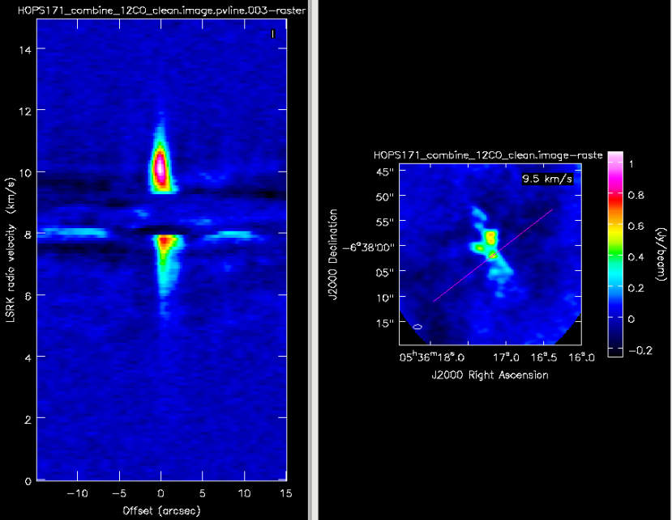
P-V Diagram (12CO)

Slide 12
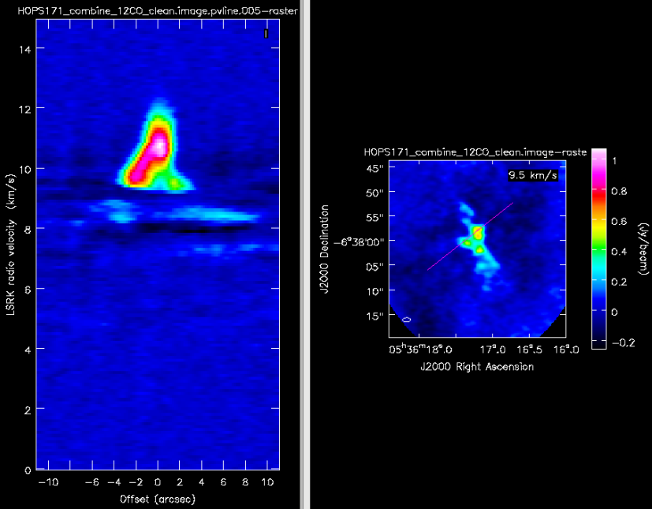
P-V Diagram (12CO)

Slide 13
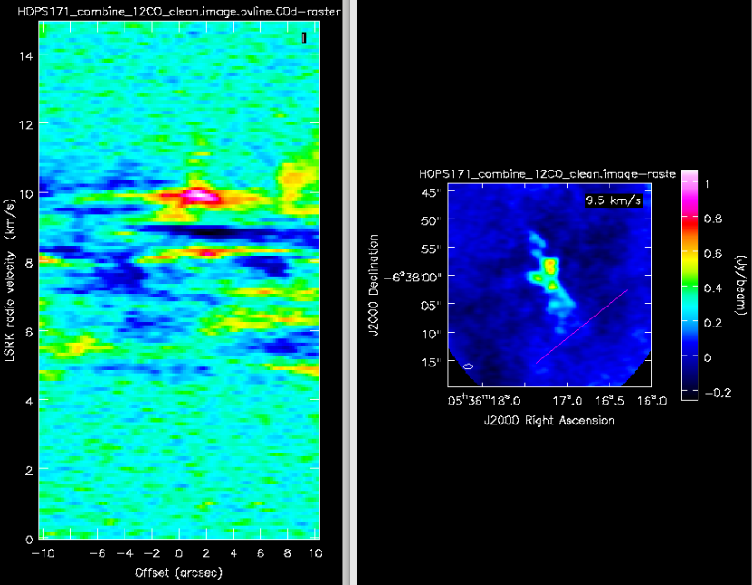
P-V Diagram (12CO)

