Slide 1
Introduction to the ALMA and Aperture Synthesis
2020 ALMA Summer School at KASI
Jongsoo Kim
KASI

Slide 2
Topics and References
Topics
  Introduction to ALMA
  Introduction to Aperture Synthesis
  Imaging and Deconvolution
References
  ALMA Cycle 7 Technical Handbook
  https://almascience.nrao.edu/documents-and-tools/cycle7/alma-technical-handbook/at_download/file
  “Imaging and Deconvolution” presented by by David J. Wilner at 17th NRAO Synthesis Imaging Workshop
  http://www.aoc.nrao.edu/events/synthesis/2020/Wilner_imaging+deconvolution_jan2020.pdf

Slide 3
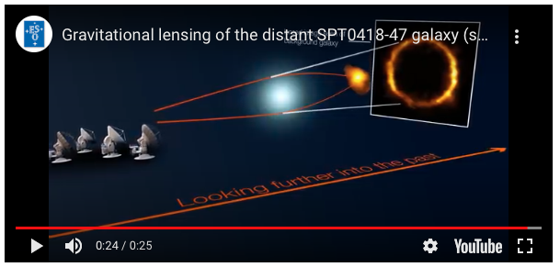
Most distance (1.4 billion years old)
MW look-alike
Nature, 2020, Rizzo+

Slide 4
Neutron star in SN 1987A
ApJ, 2019, Cigan+; ApJ, 2020, Page+

Slide 5
12m, 7m, TP Arrays

Slide 6
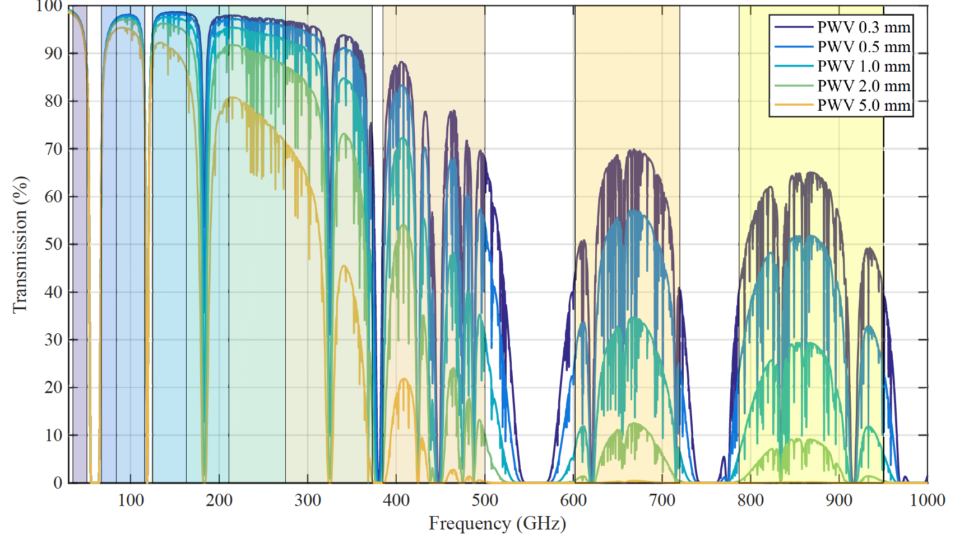
Transmission in all ALMA bands at Zenith

Slide 7
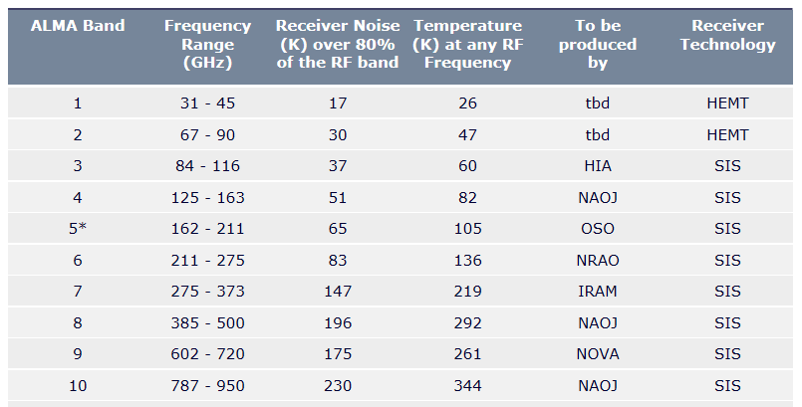
ALMA
Receivers
Band 3
Band 9

Slide 8
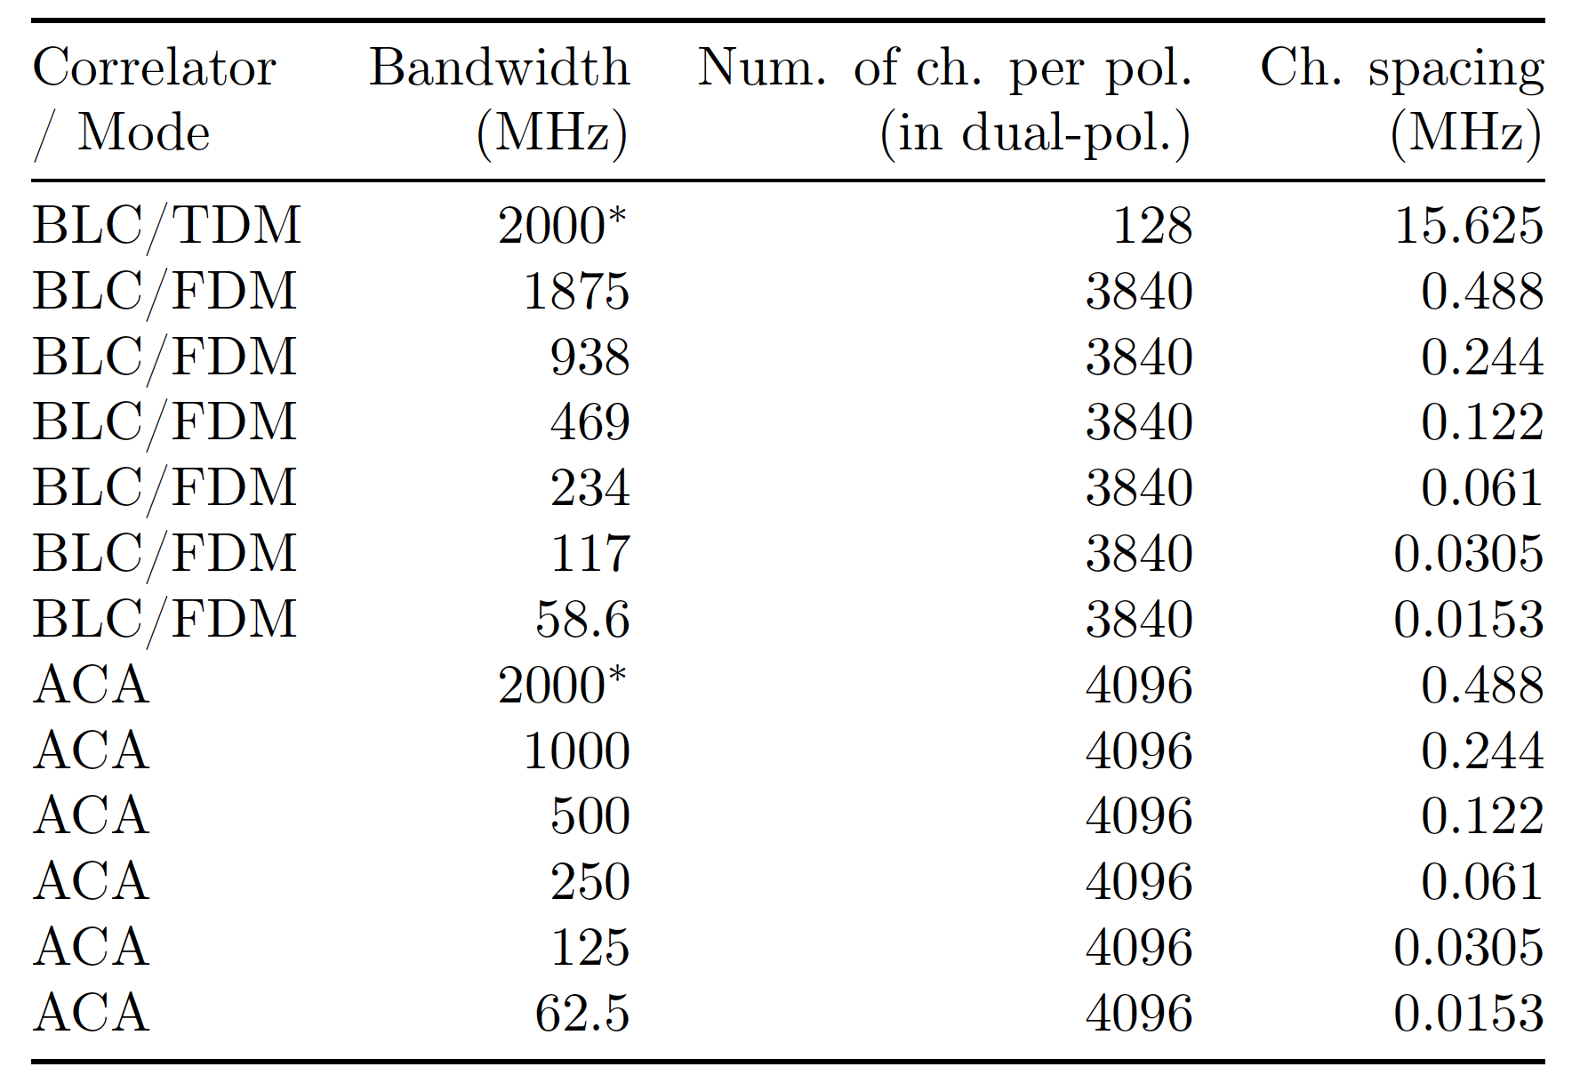
BaseLine/ACA Correlators

Slide 10
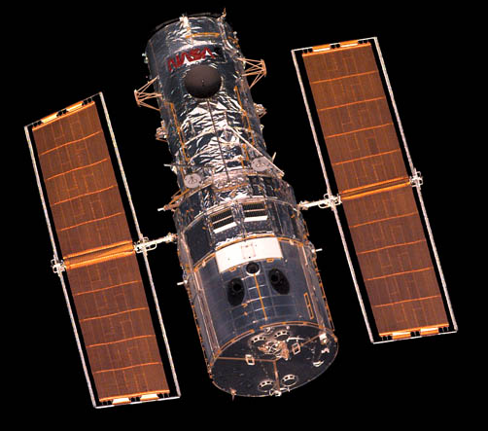
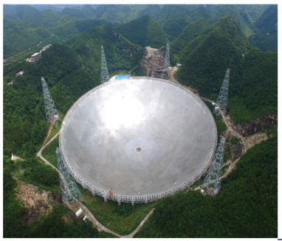

Angular Resolution
Resolution of single aperture, $θ$~$\frac{λ}{D}$
  Eye: D~8mm, $λ$=500 nm, $θ$~ 2’
  HST: D=2.4 m, $λ$=500 nm, $θ$~ 0.05”
  TRAO: D=14 m, $λ$=3mm, $θ$~ 50”
  FAST: D=300 m, $λ$=0.1 m, $θ$~ 1’
Resolution of interferometer, $θ$~$\frac{λ}{B}$
  ALMA: 0.2” ($λ$/1mm)(1km/B)
  KVN: ~ 1 milliarcsec at $υ$=129 GHz, B=500 km

Slide 11
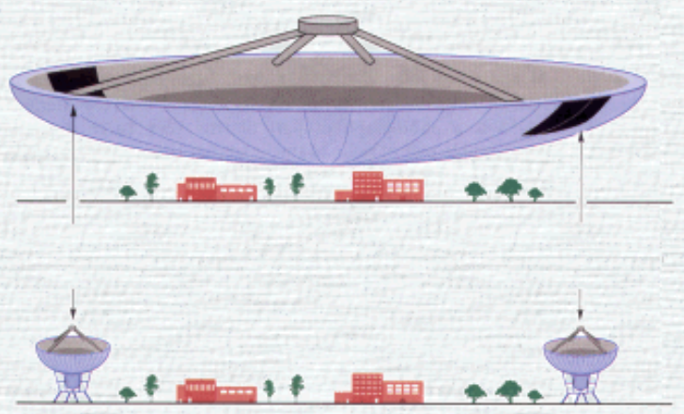
Sir Martin Ryle
One-mile telescope, 2 fixed antennas + 1 movable antenna, 18m
Ryle (together with Antony Hewish) got Novel Prize in 1974 in recognition of the development of aperture synthesis.

Slide 12
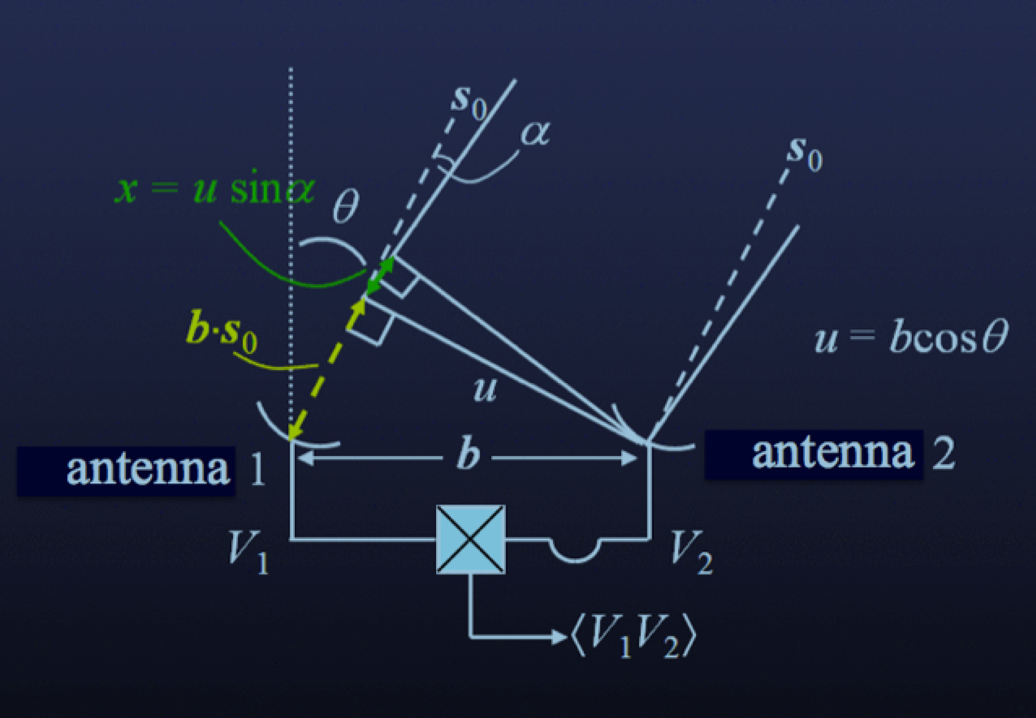
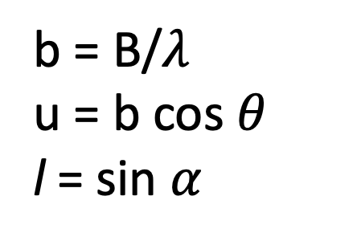
Definitions of u and l
b = B/$λ$
u = b cos $θ$
l = sin $α$

Slide 16
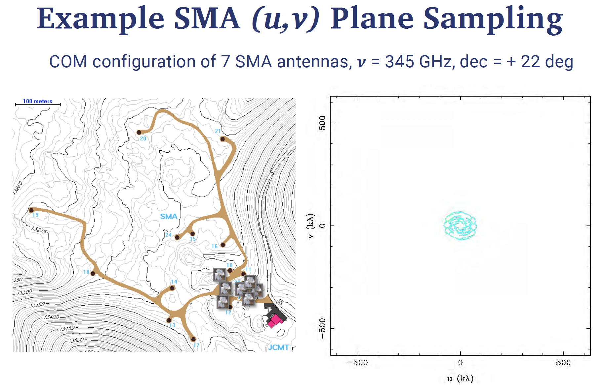

Slide 17
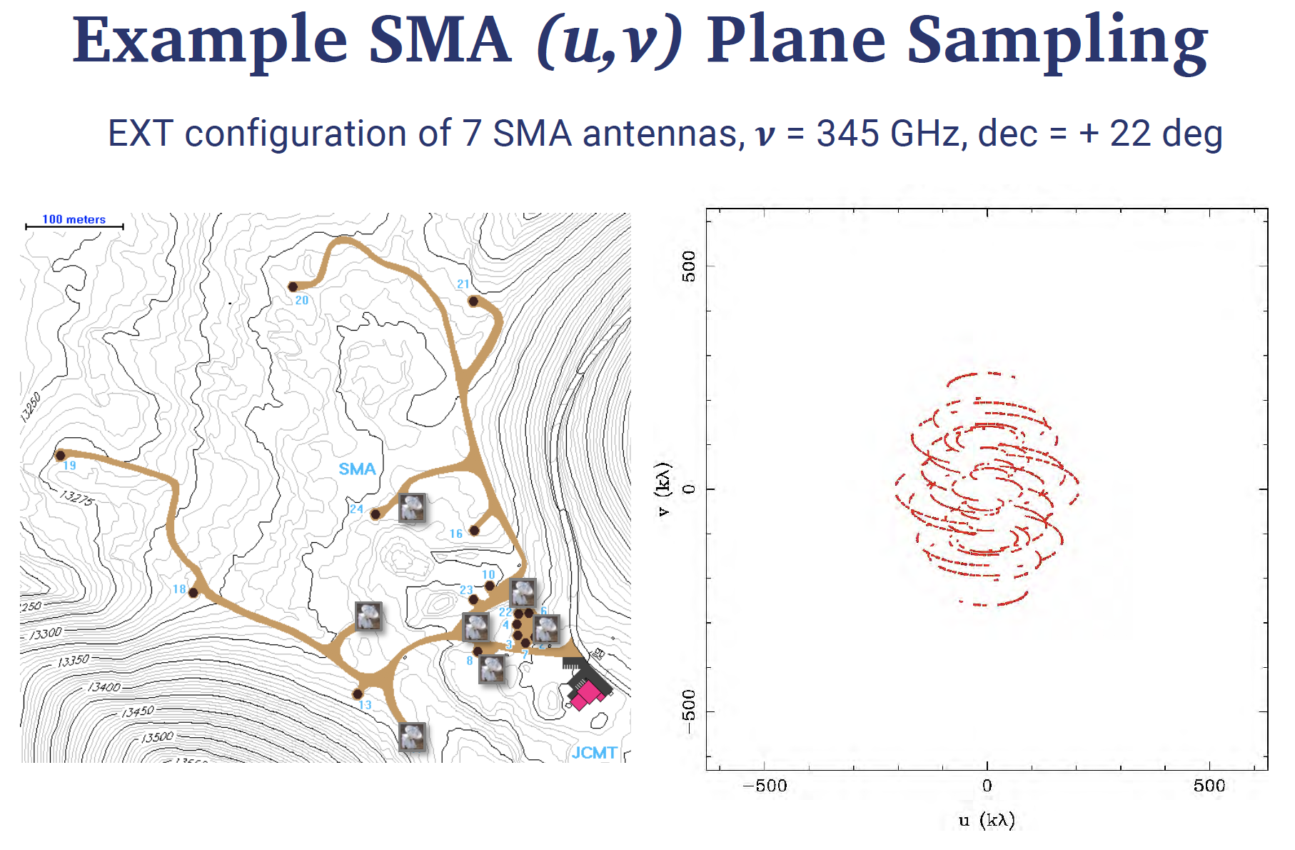

Slide 18
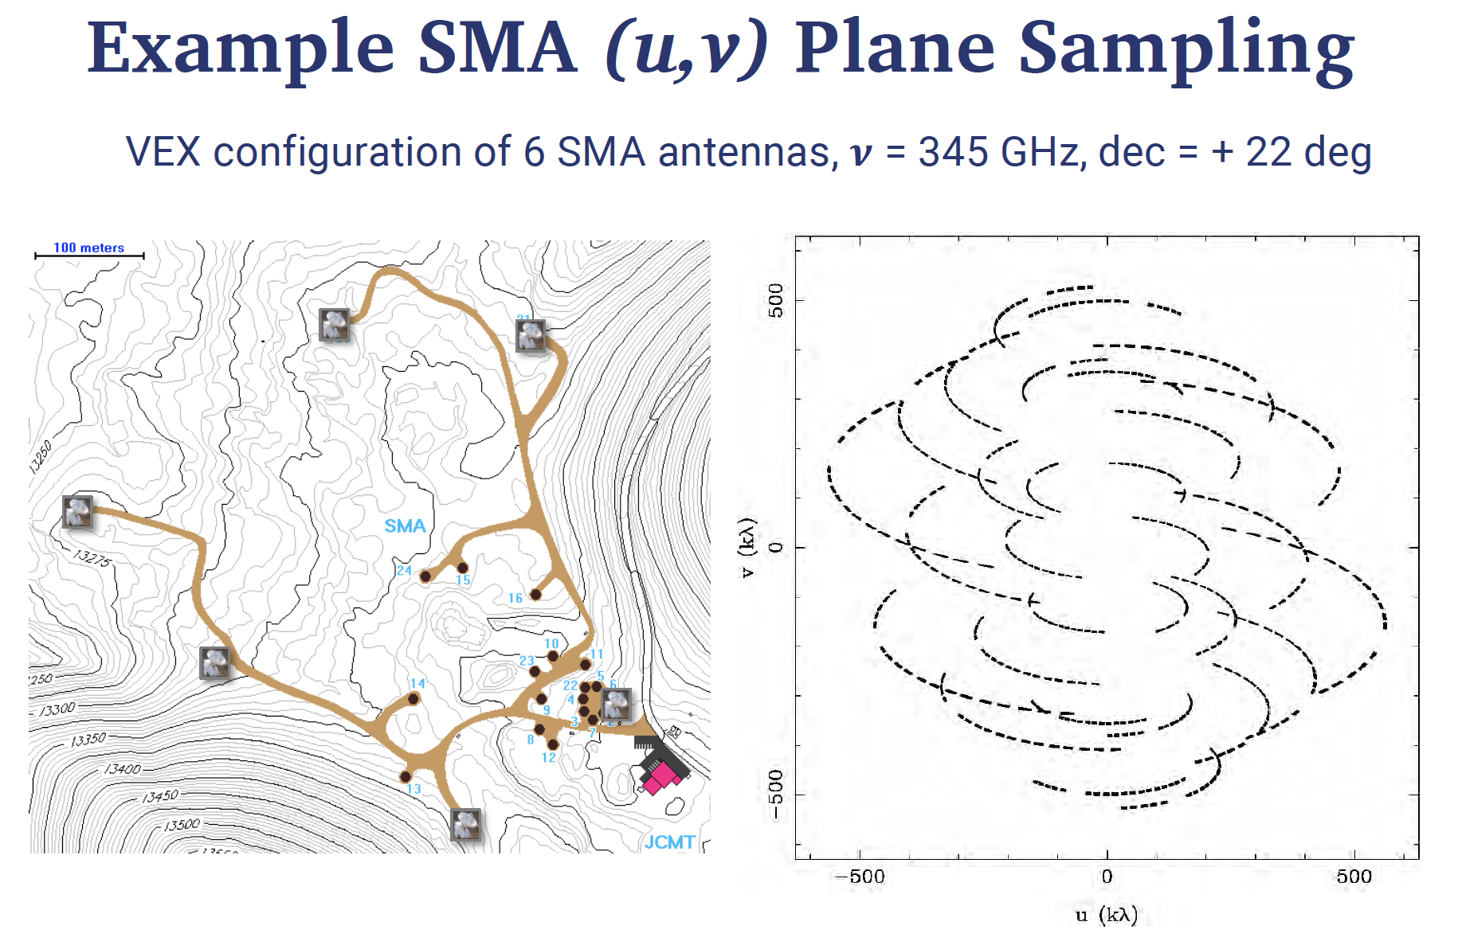

Slide 19
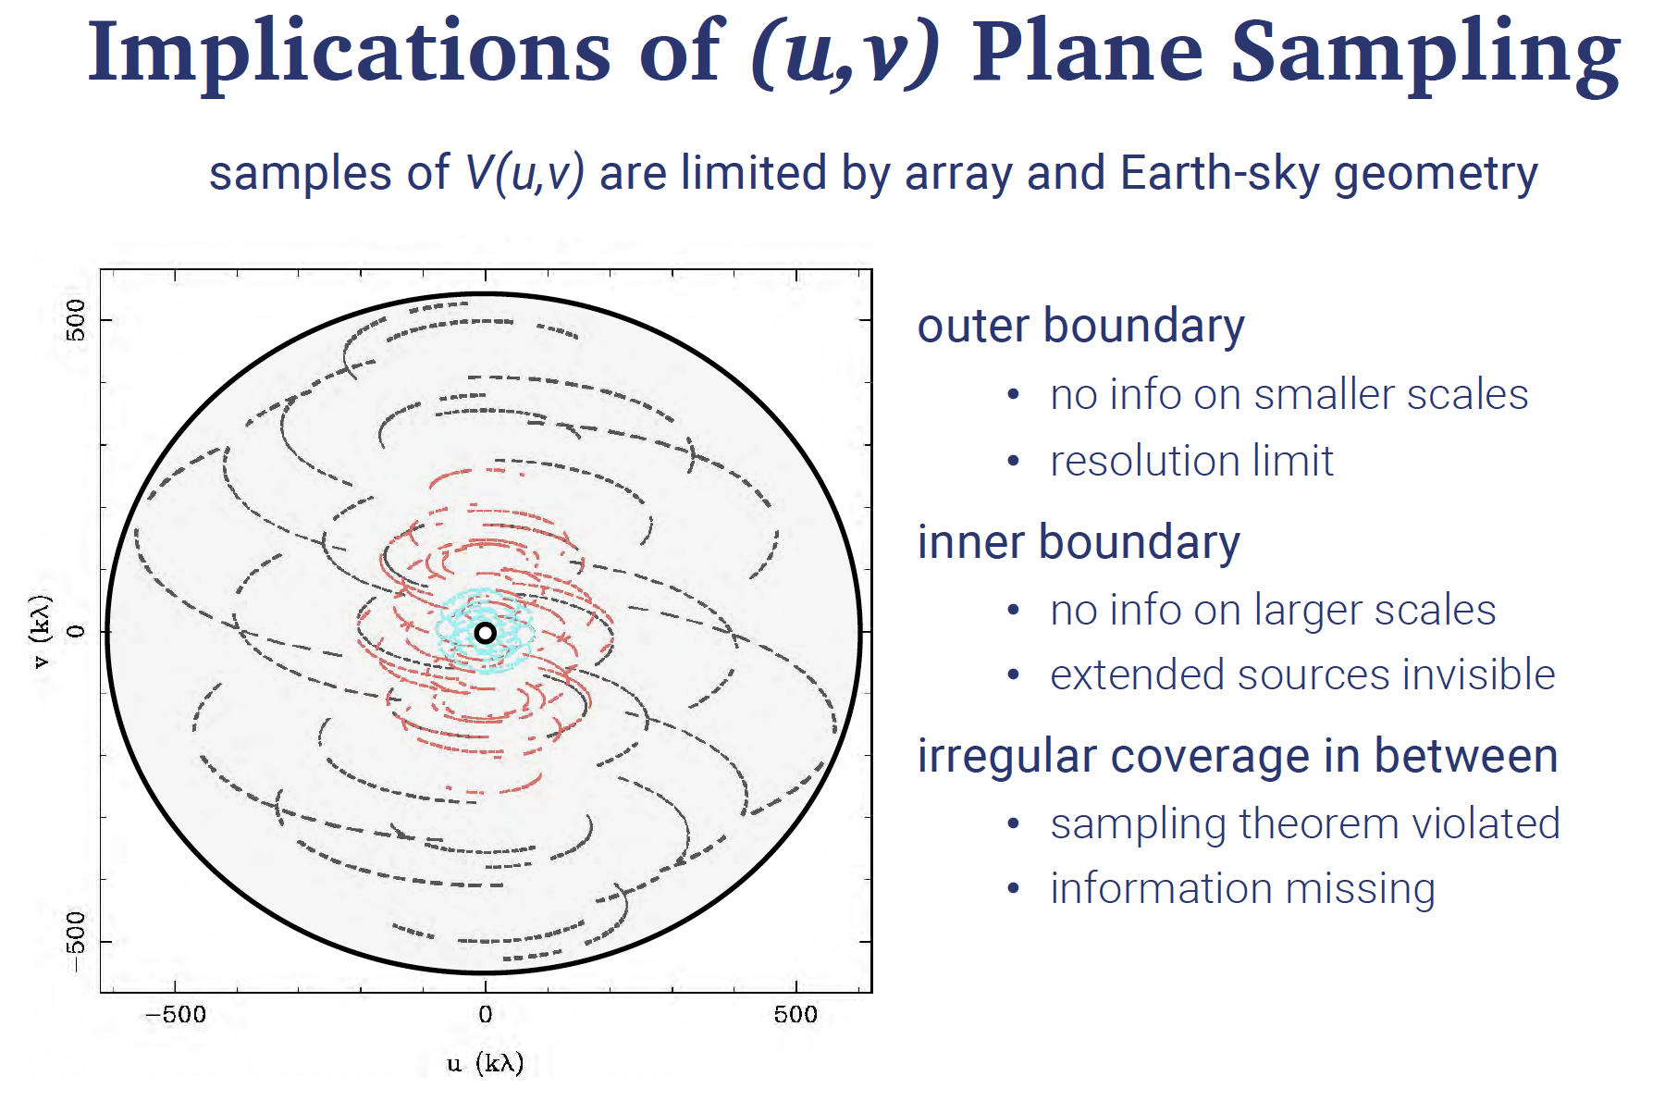

Slide 20
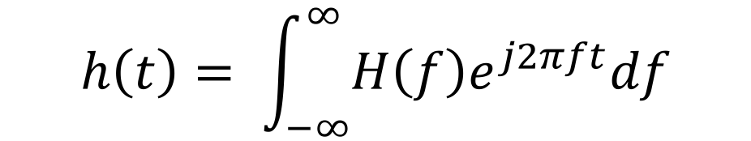
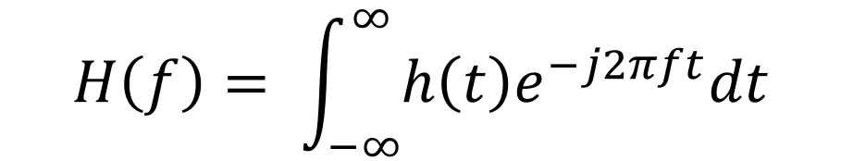
Continuous Fourier Transform
$$H\left(f\right)= \int_{−∞}^{∞}{h\left(t\right)e^{−j2πft}dt}$$
$$h\left(t\right)= \int_{−∞}^{∞}{H\left(f\right)e^{j2πft}df}$$

Slide 24
Calibrations
flagging
WVR (Water Vapor Radiometer): phase delay due to the atmosphere
  Correct short time phase variation
Tsys: atmospheric emission/opacity
  Gain transfer across elevation
  100 K at Band 3 and 1000 K at Band 9
Bandpass: calibrate the frequency response mostly due to receivers
Gain: calibration of complex gain (amplitude and phase)
Flux: set flux scale using the known flux of a flux calibrator

Slide 25
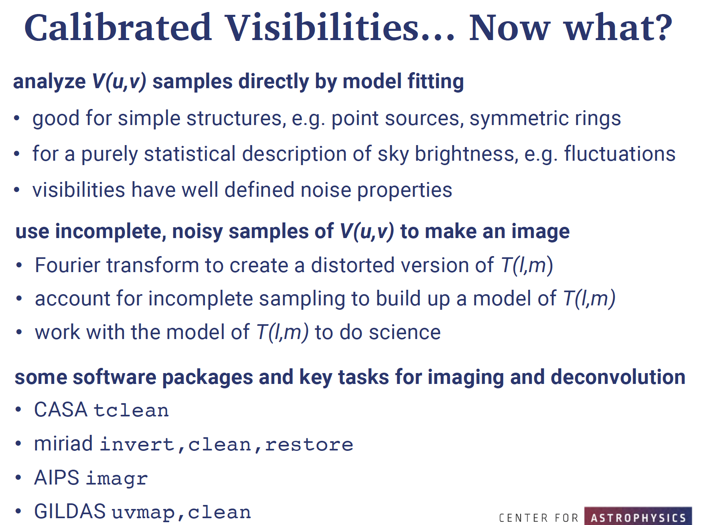

Slide 26
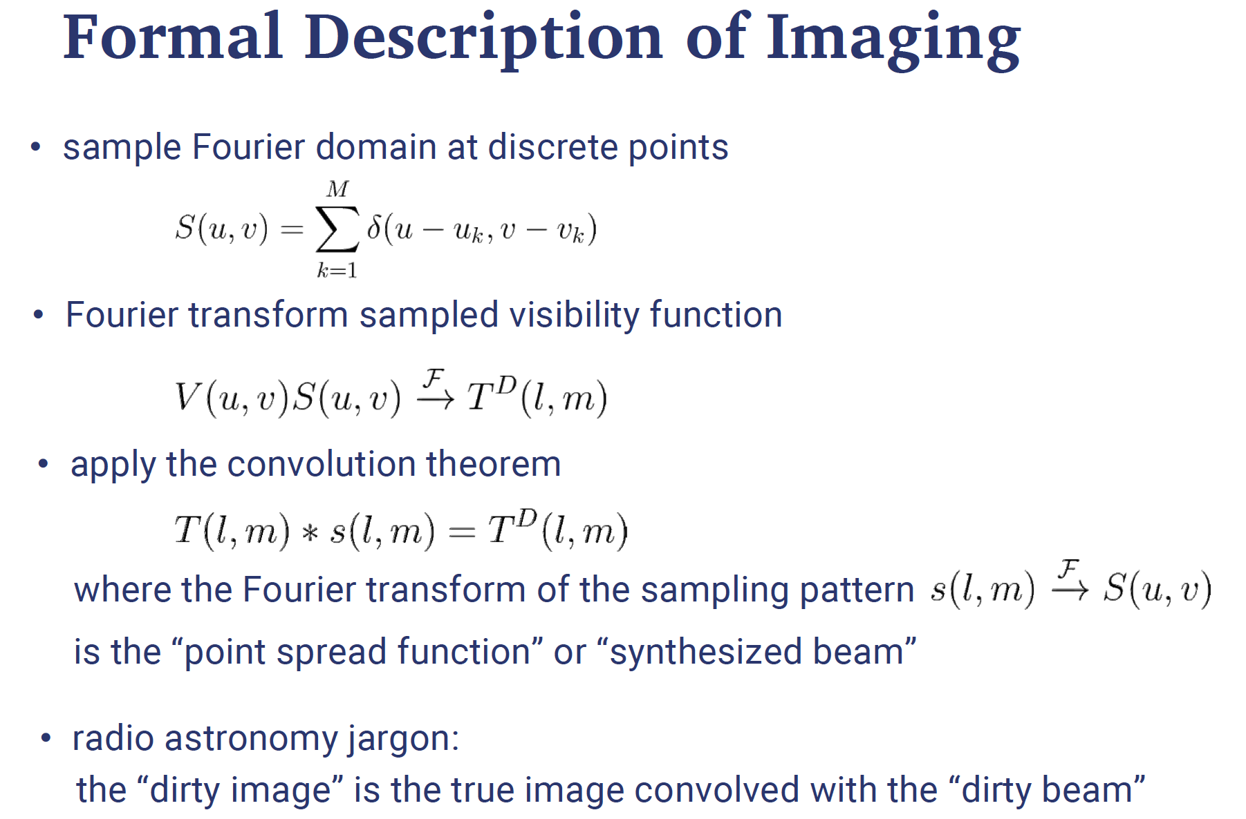

Slide 27
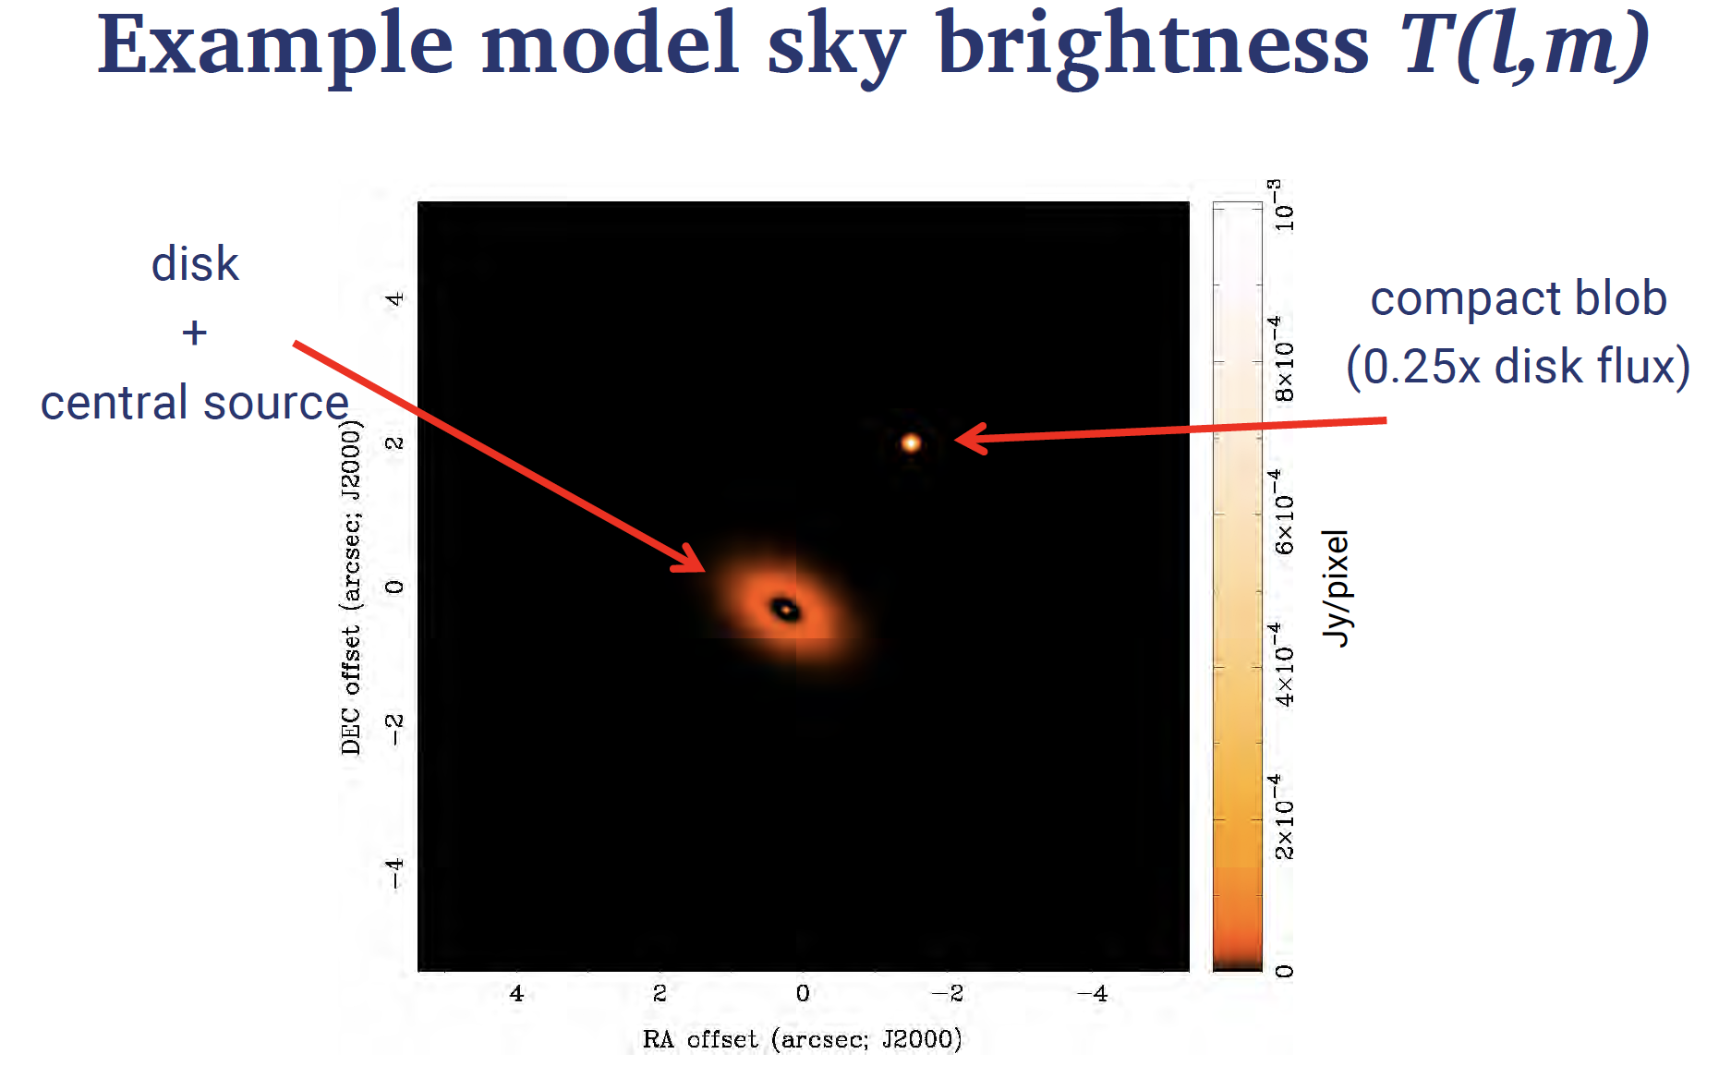

Slide 28
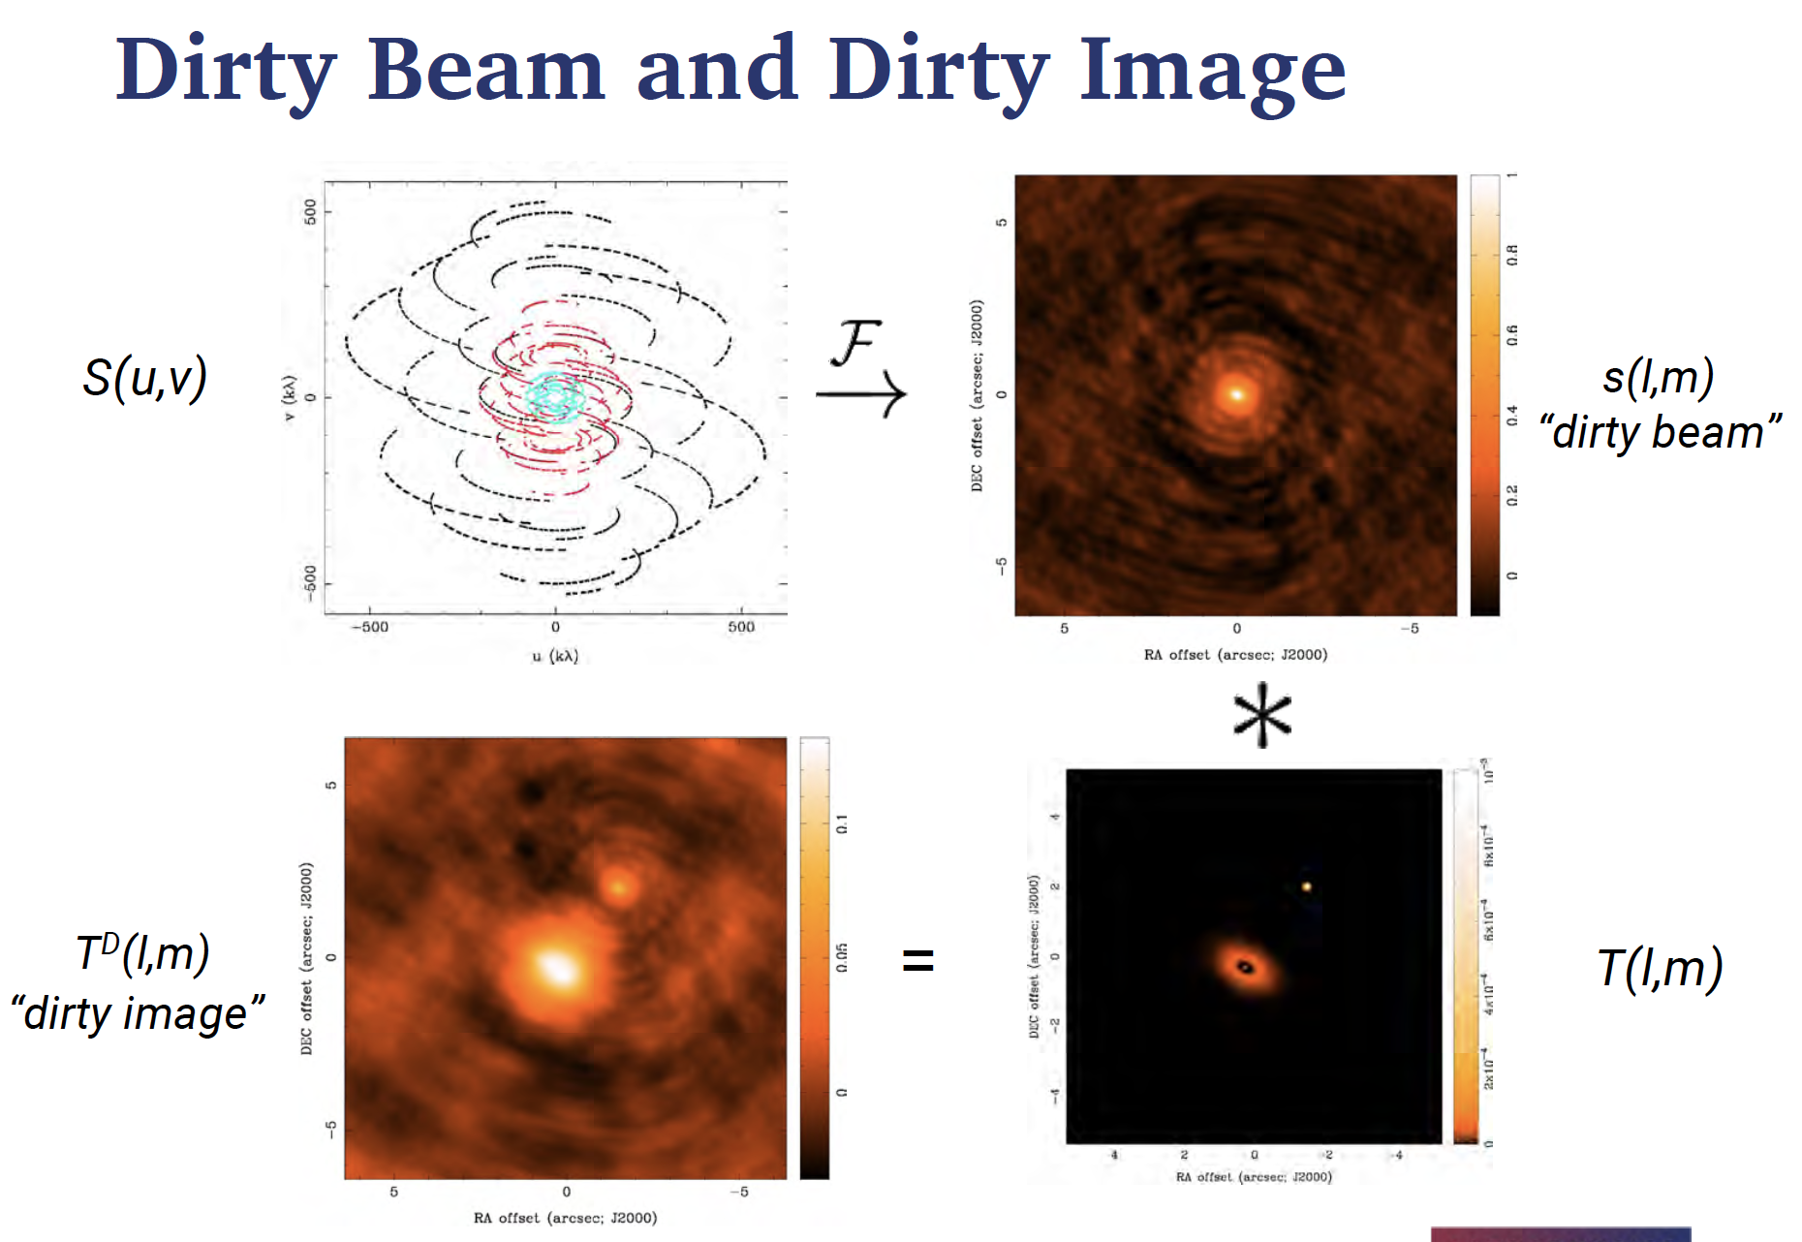

Slide 29
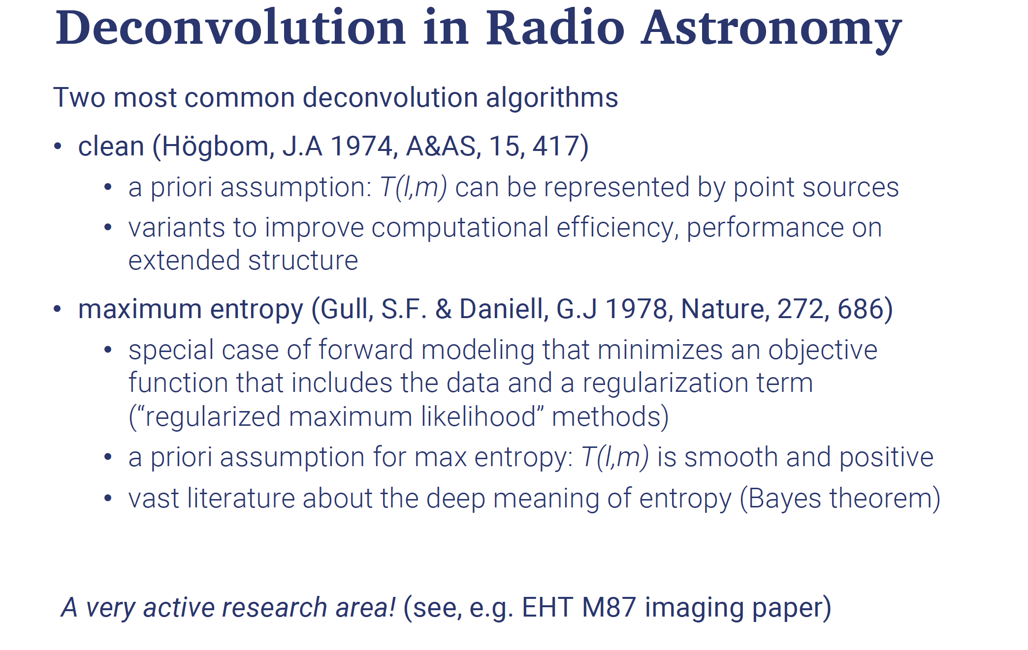

Slide 30
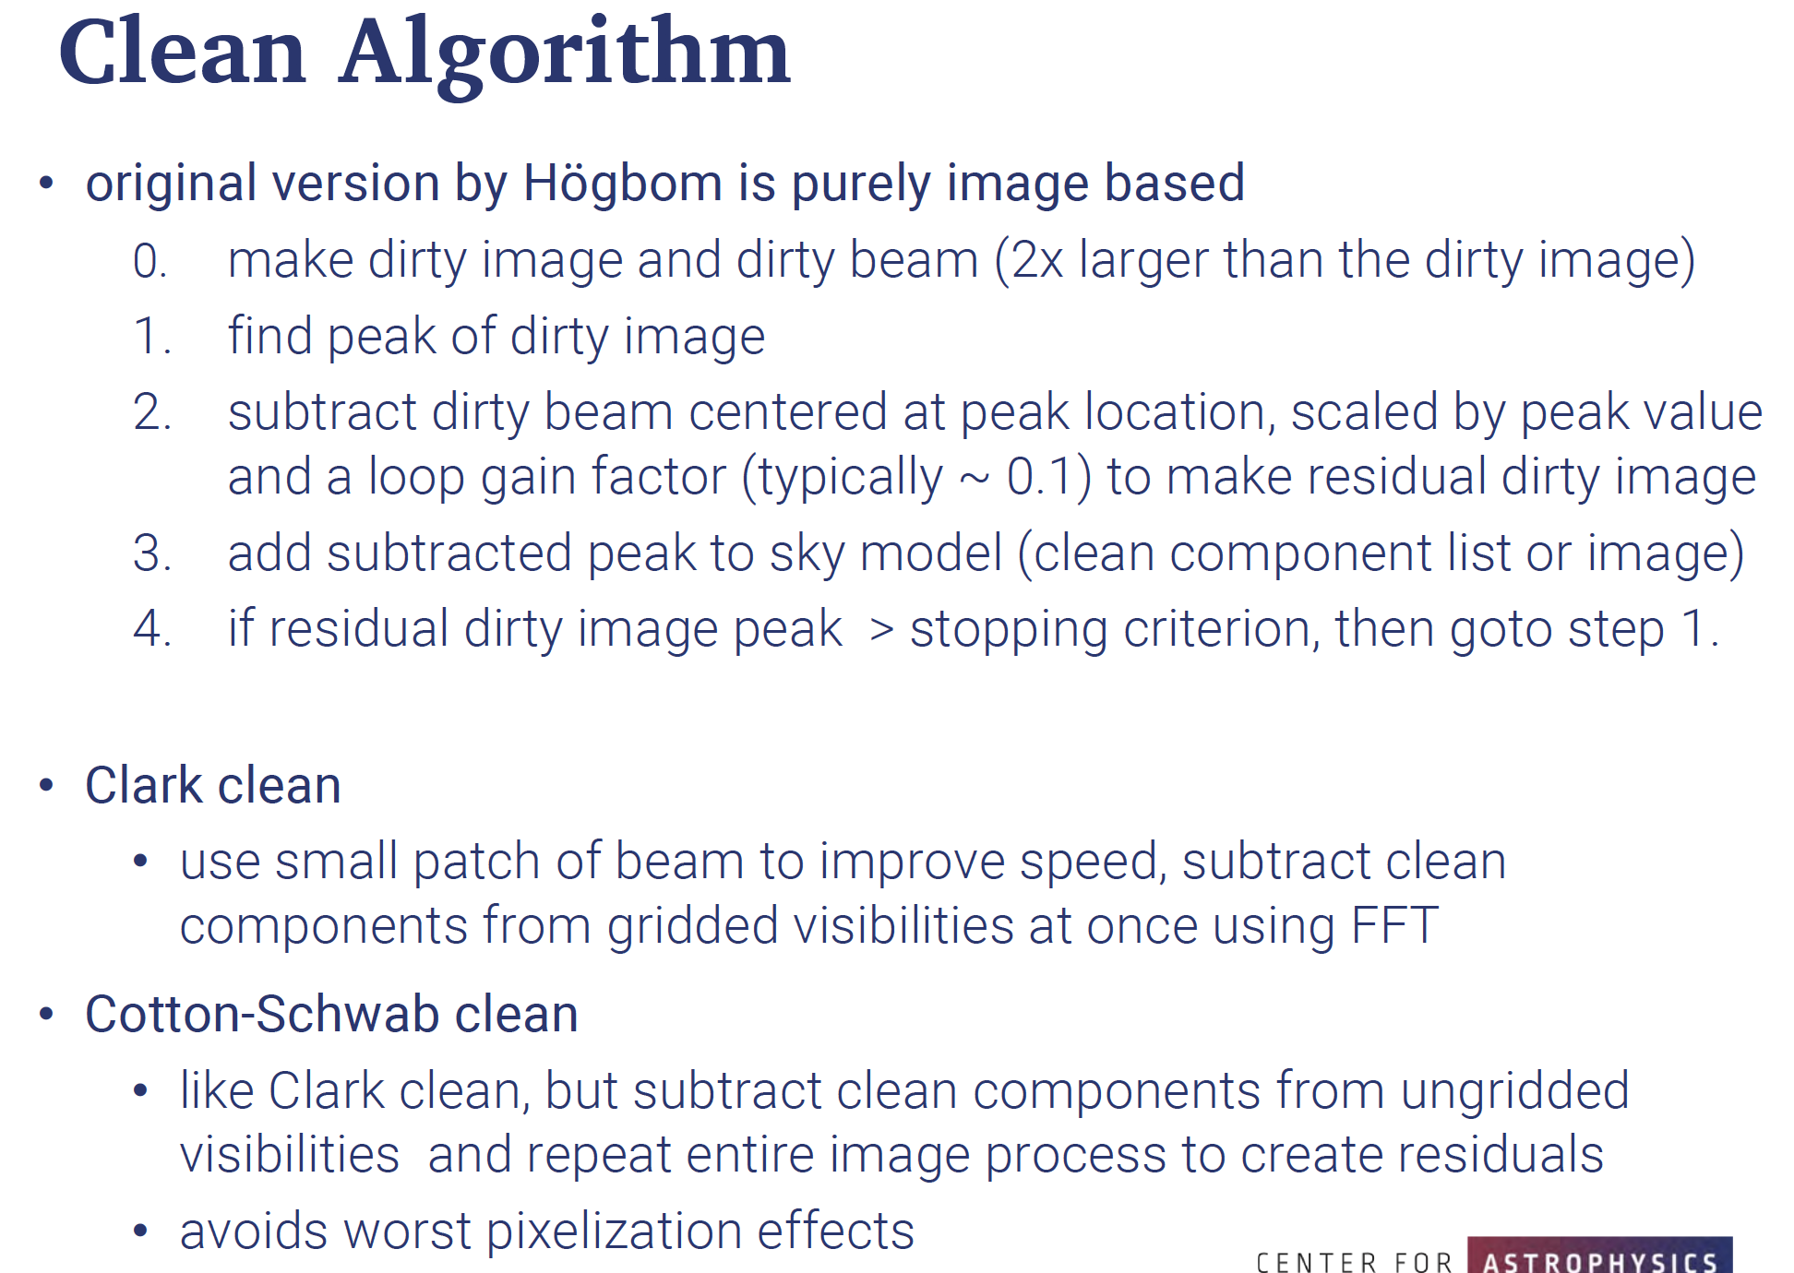

Slide 31
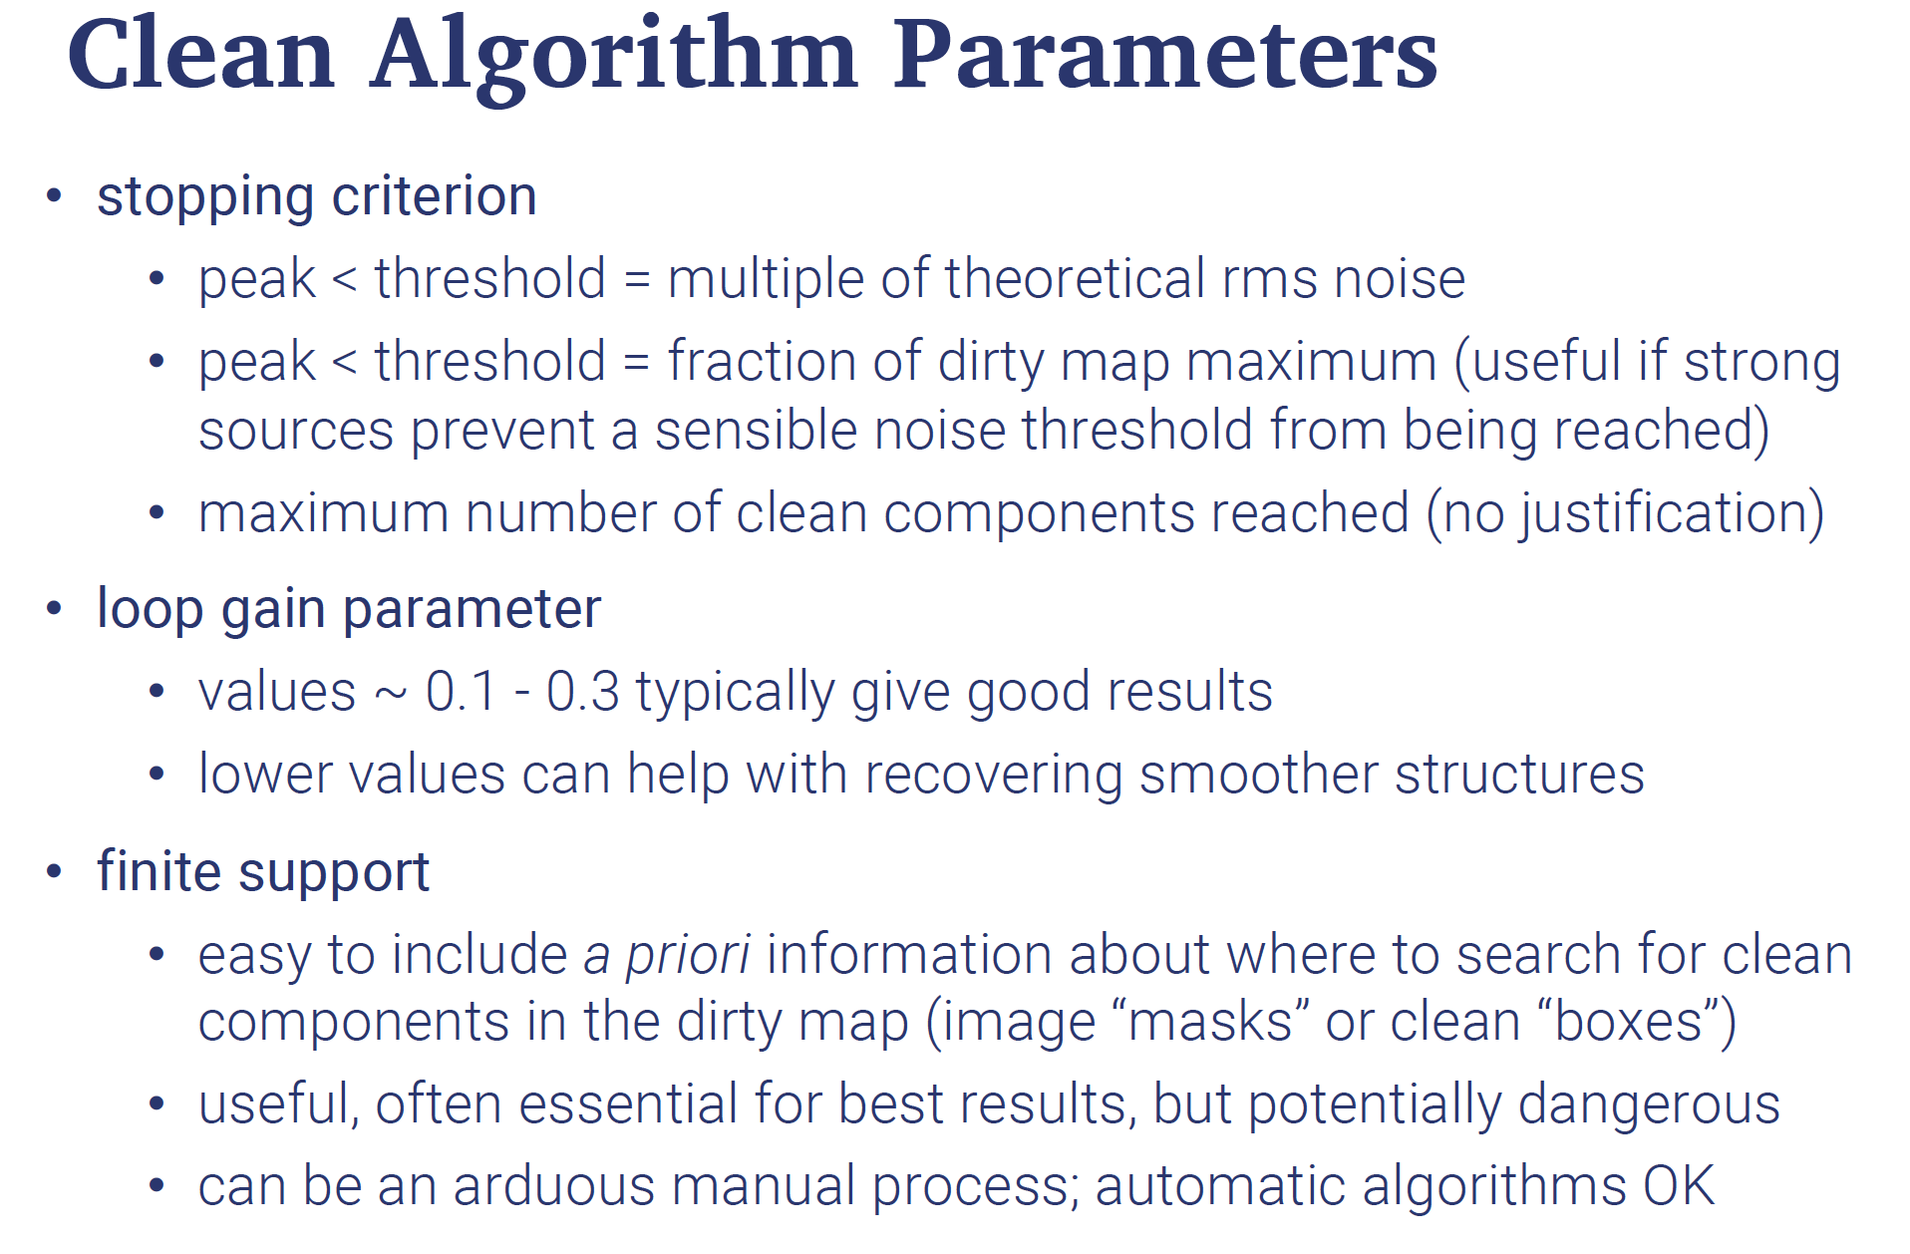

Slide 32
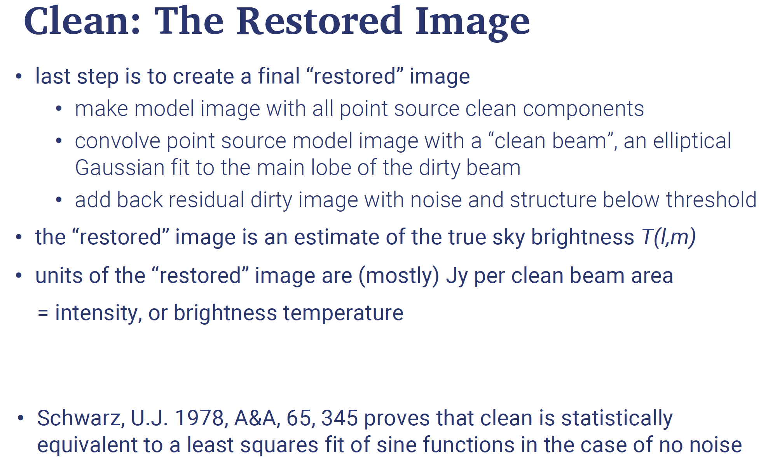

Slide 33
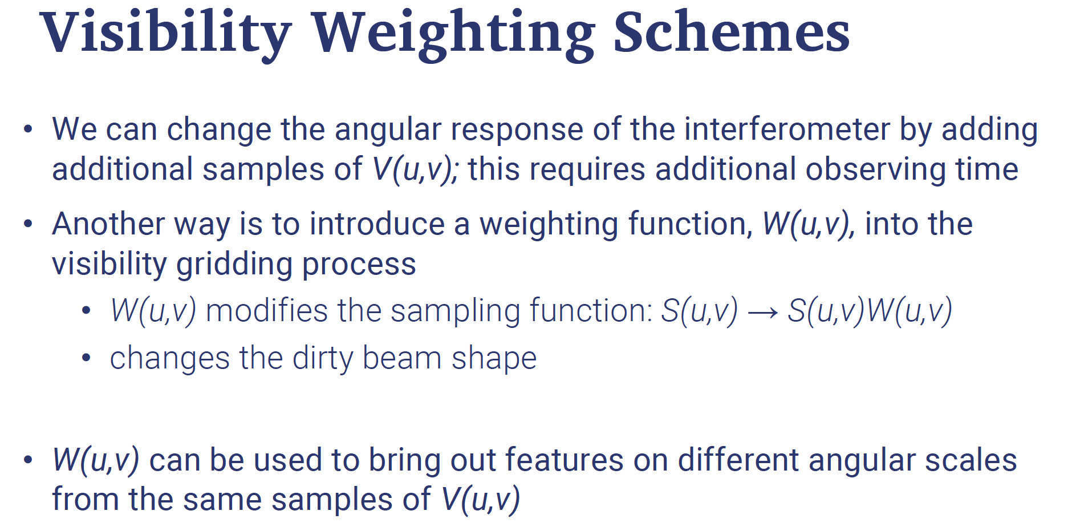

Slide 34
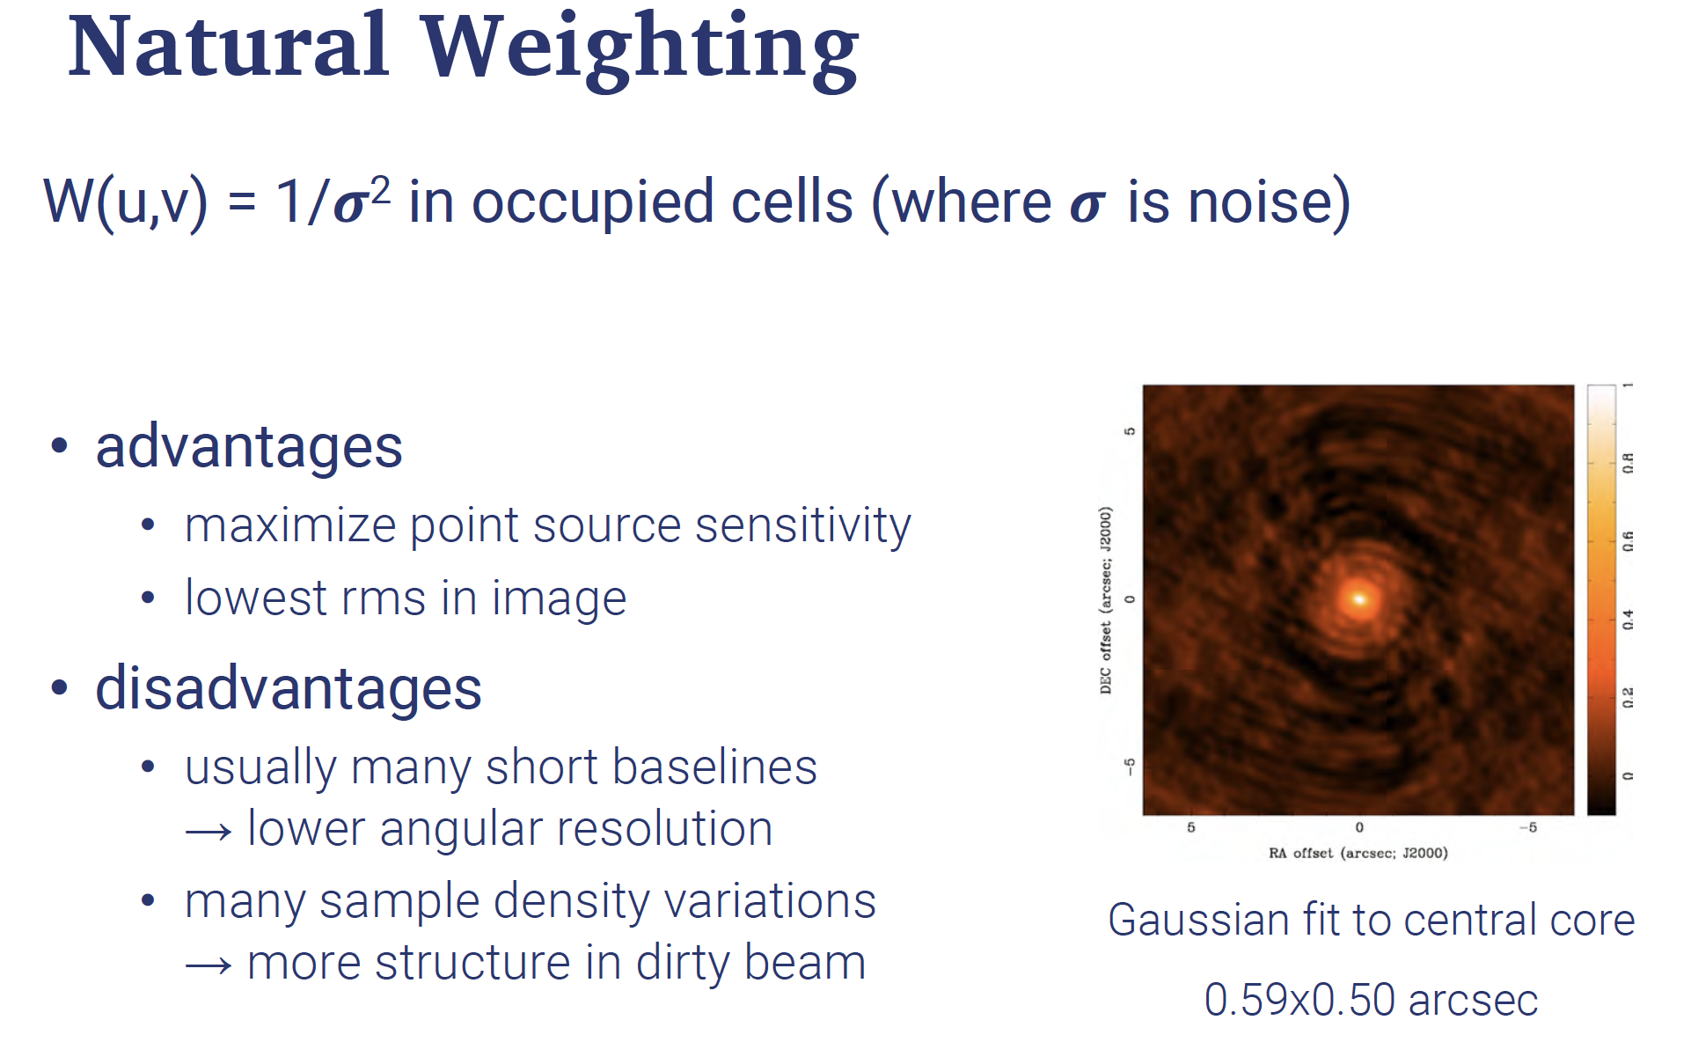

Slide 35
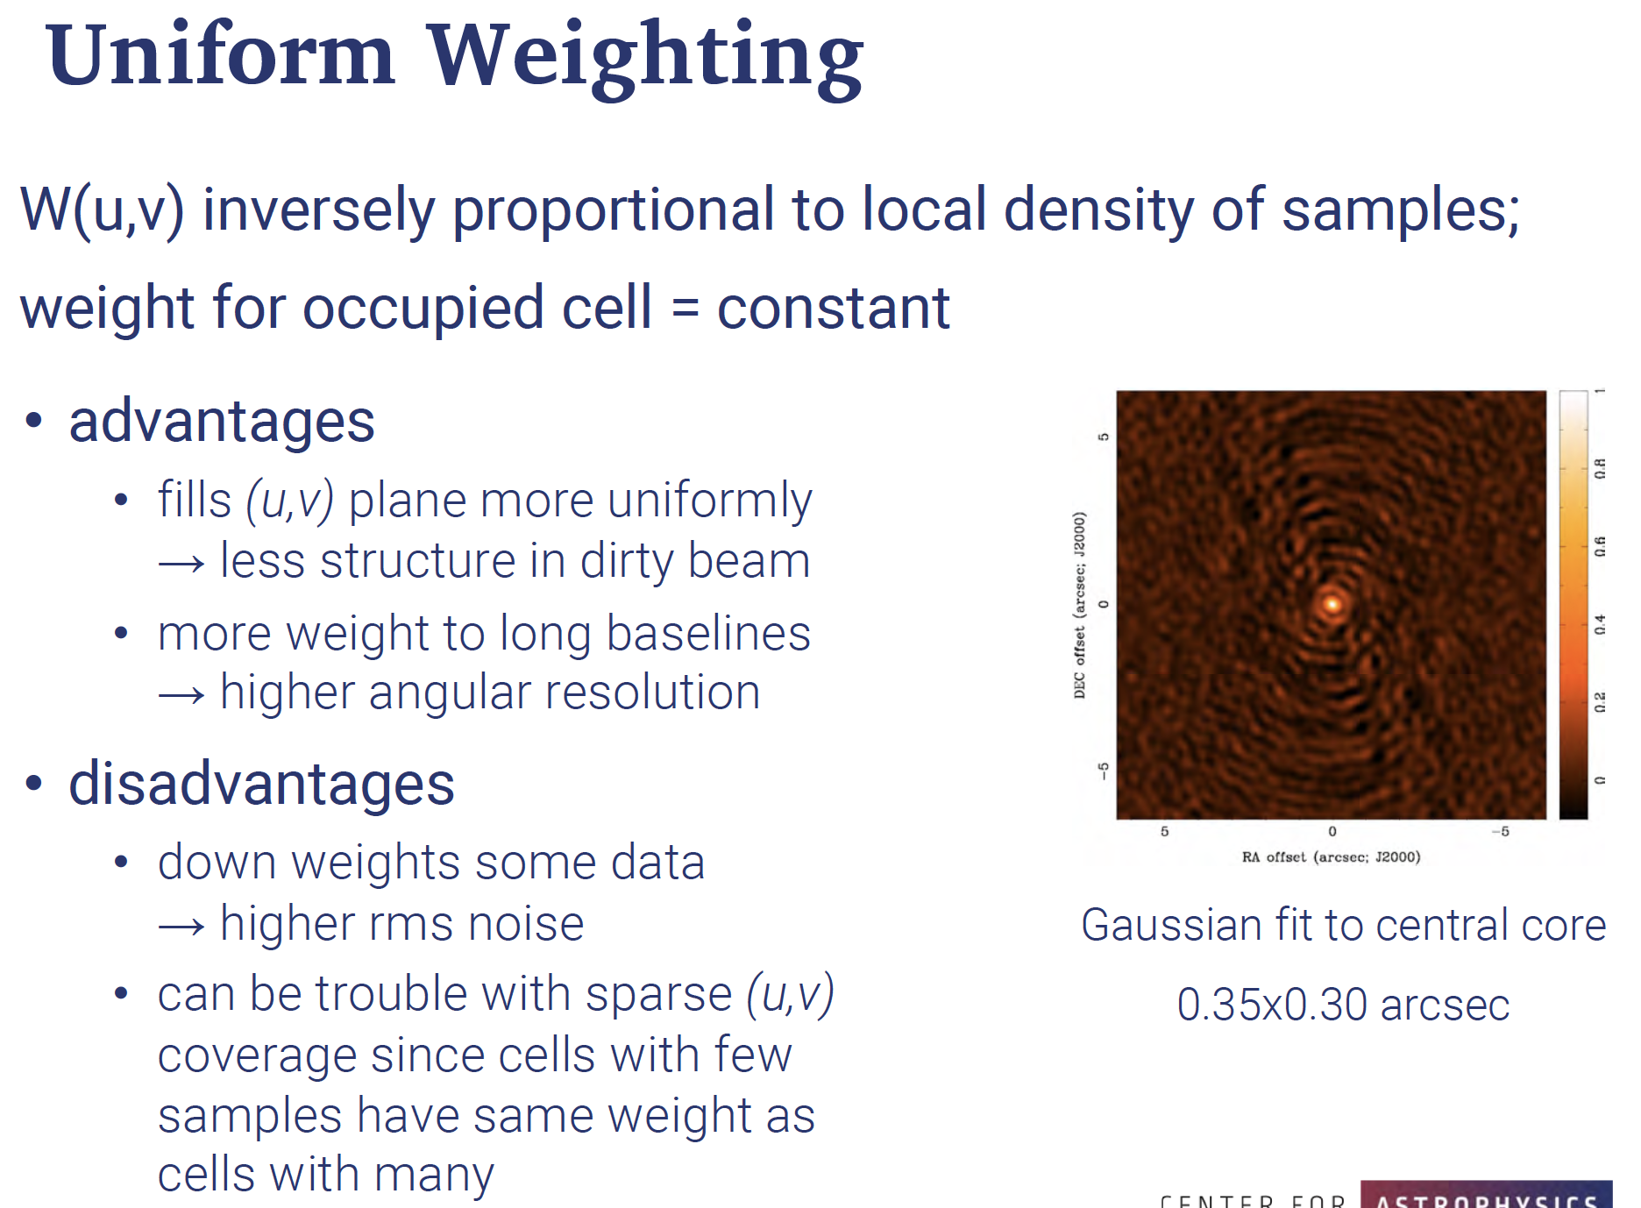

Slide 36
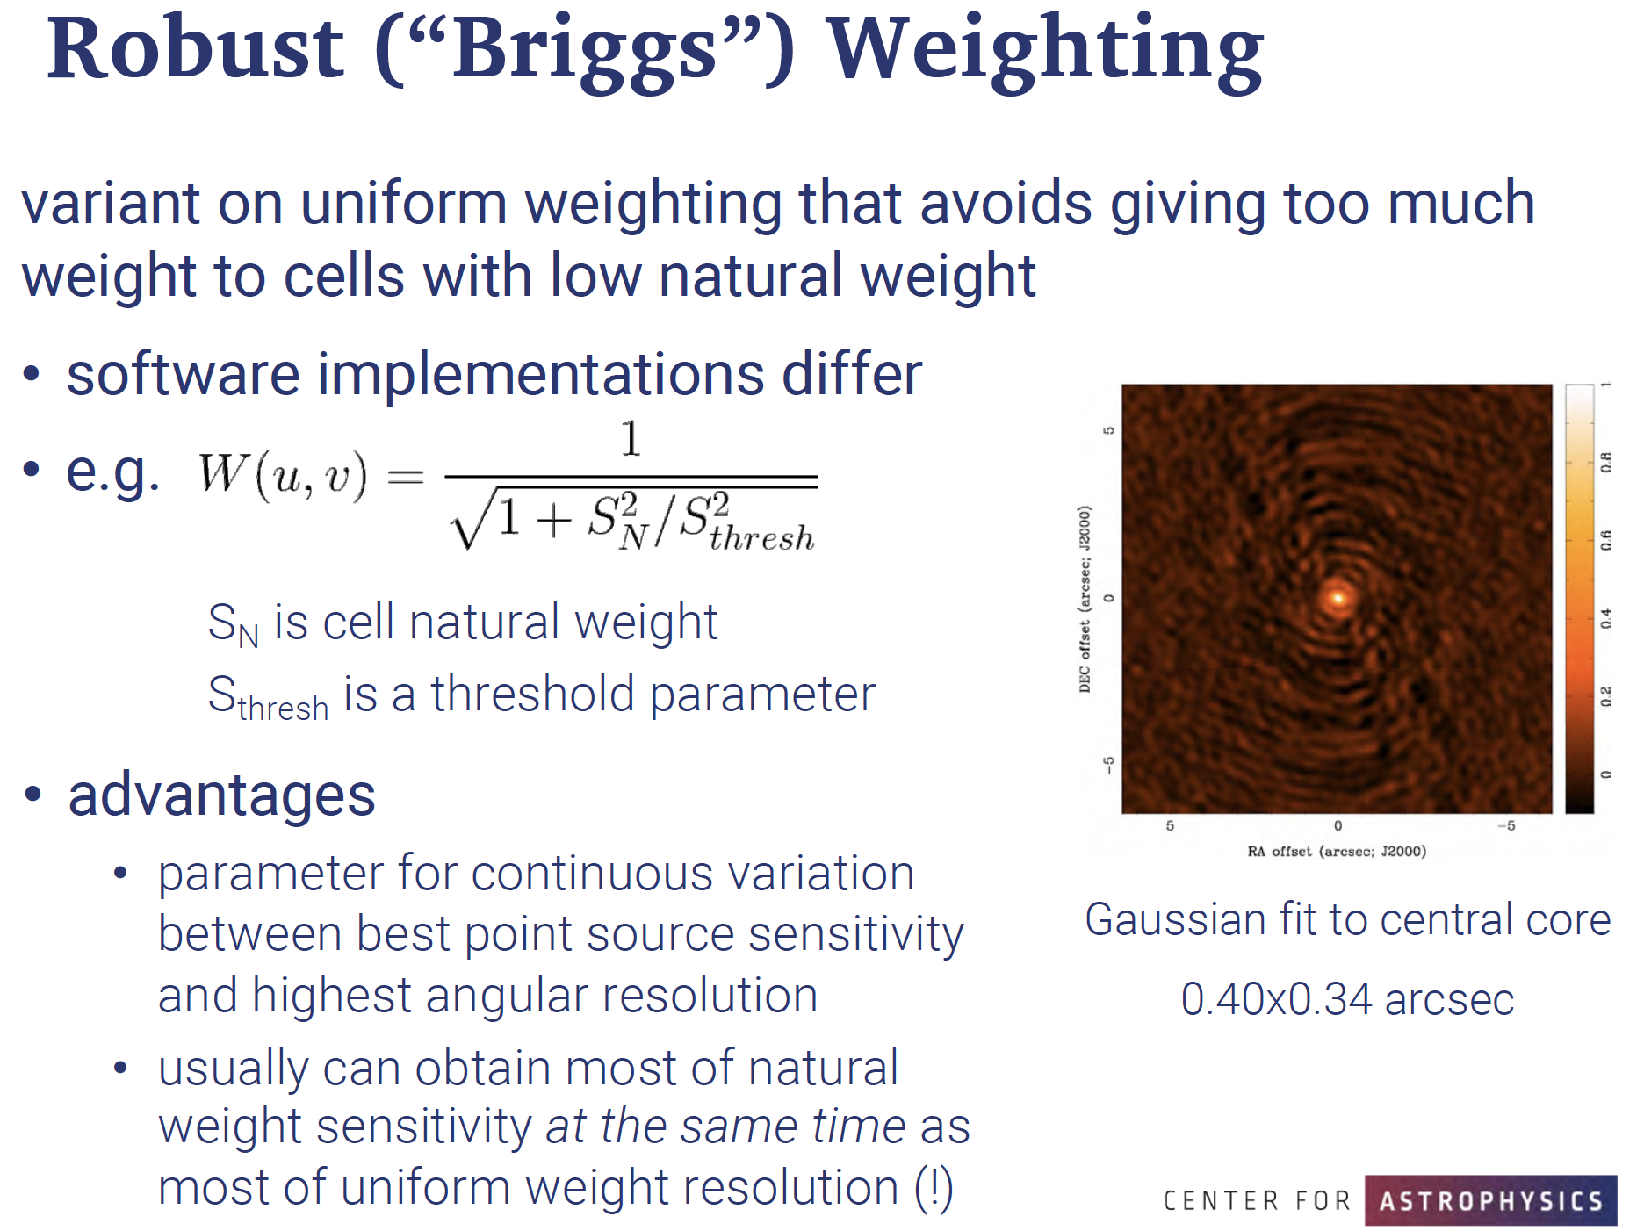

Slide 37
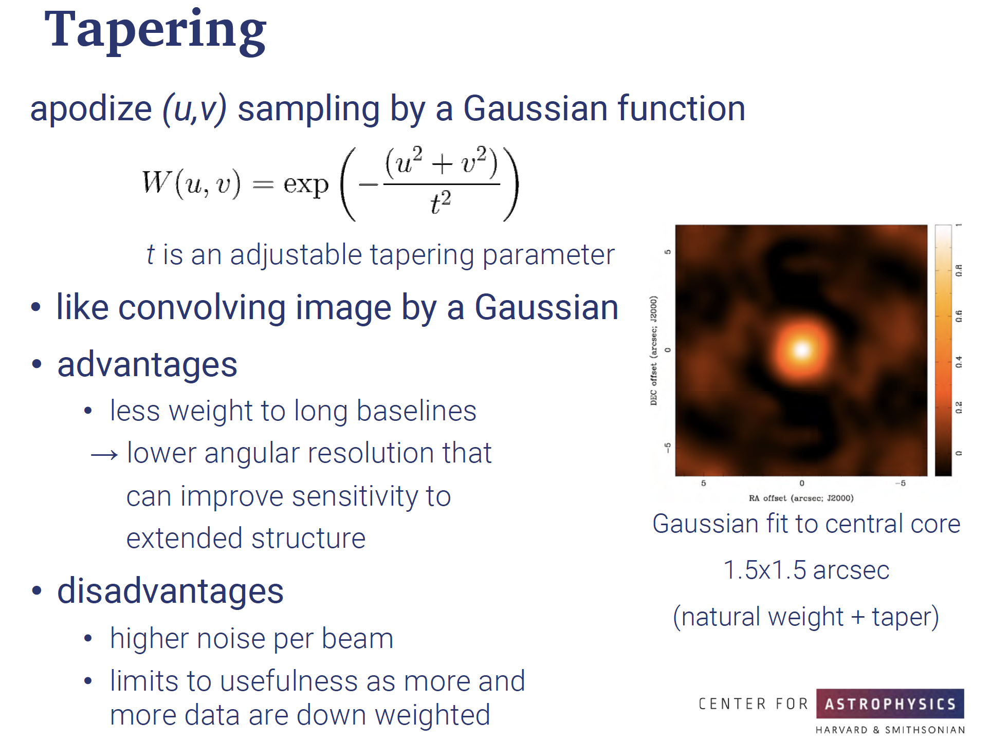

Slide 38
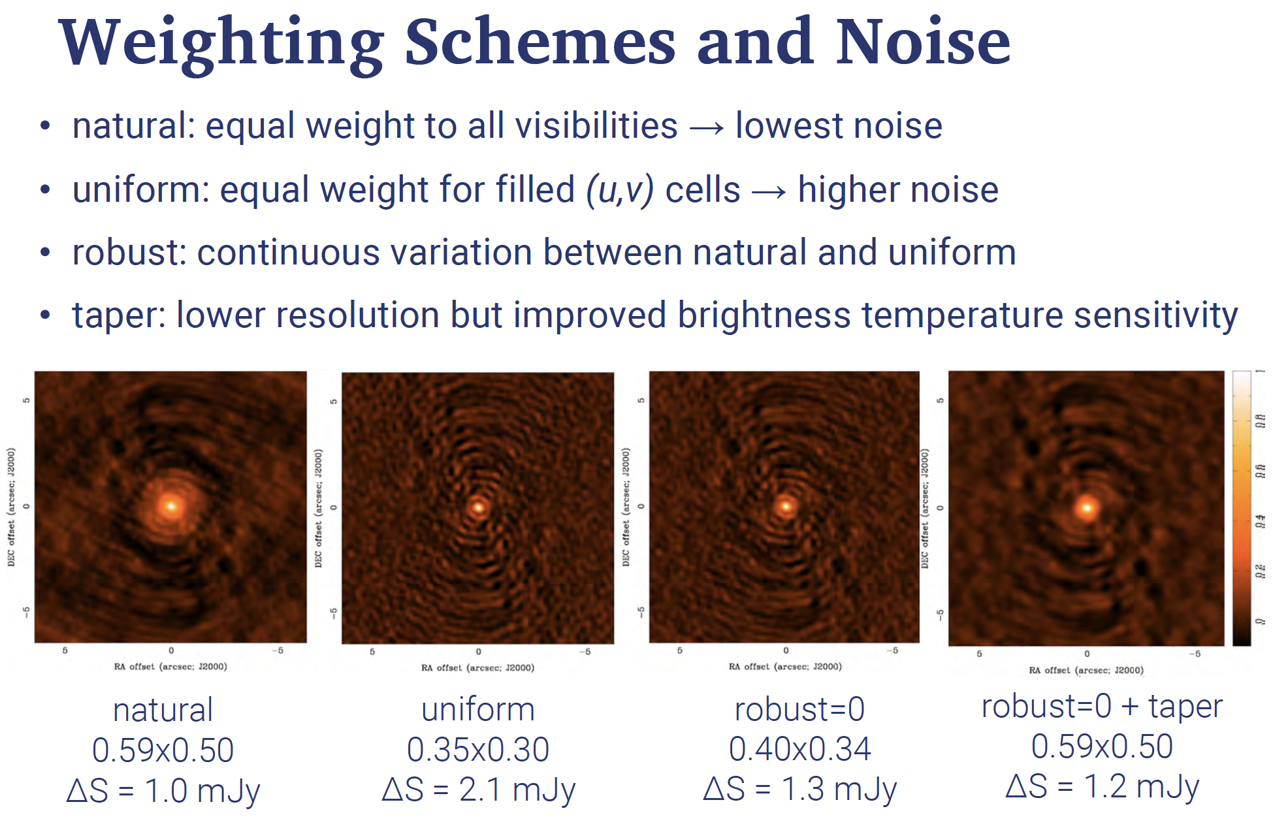

Slide 39
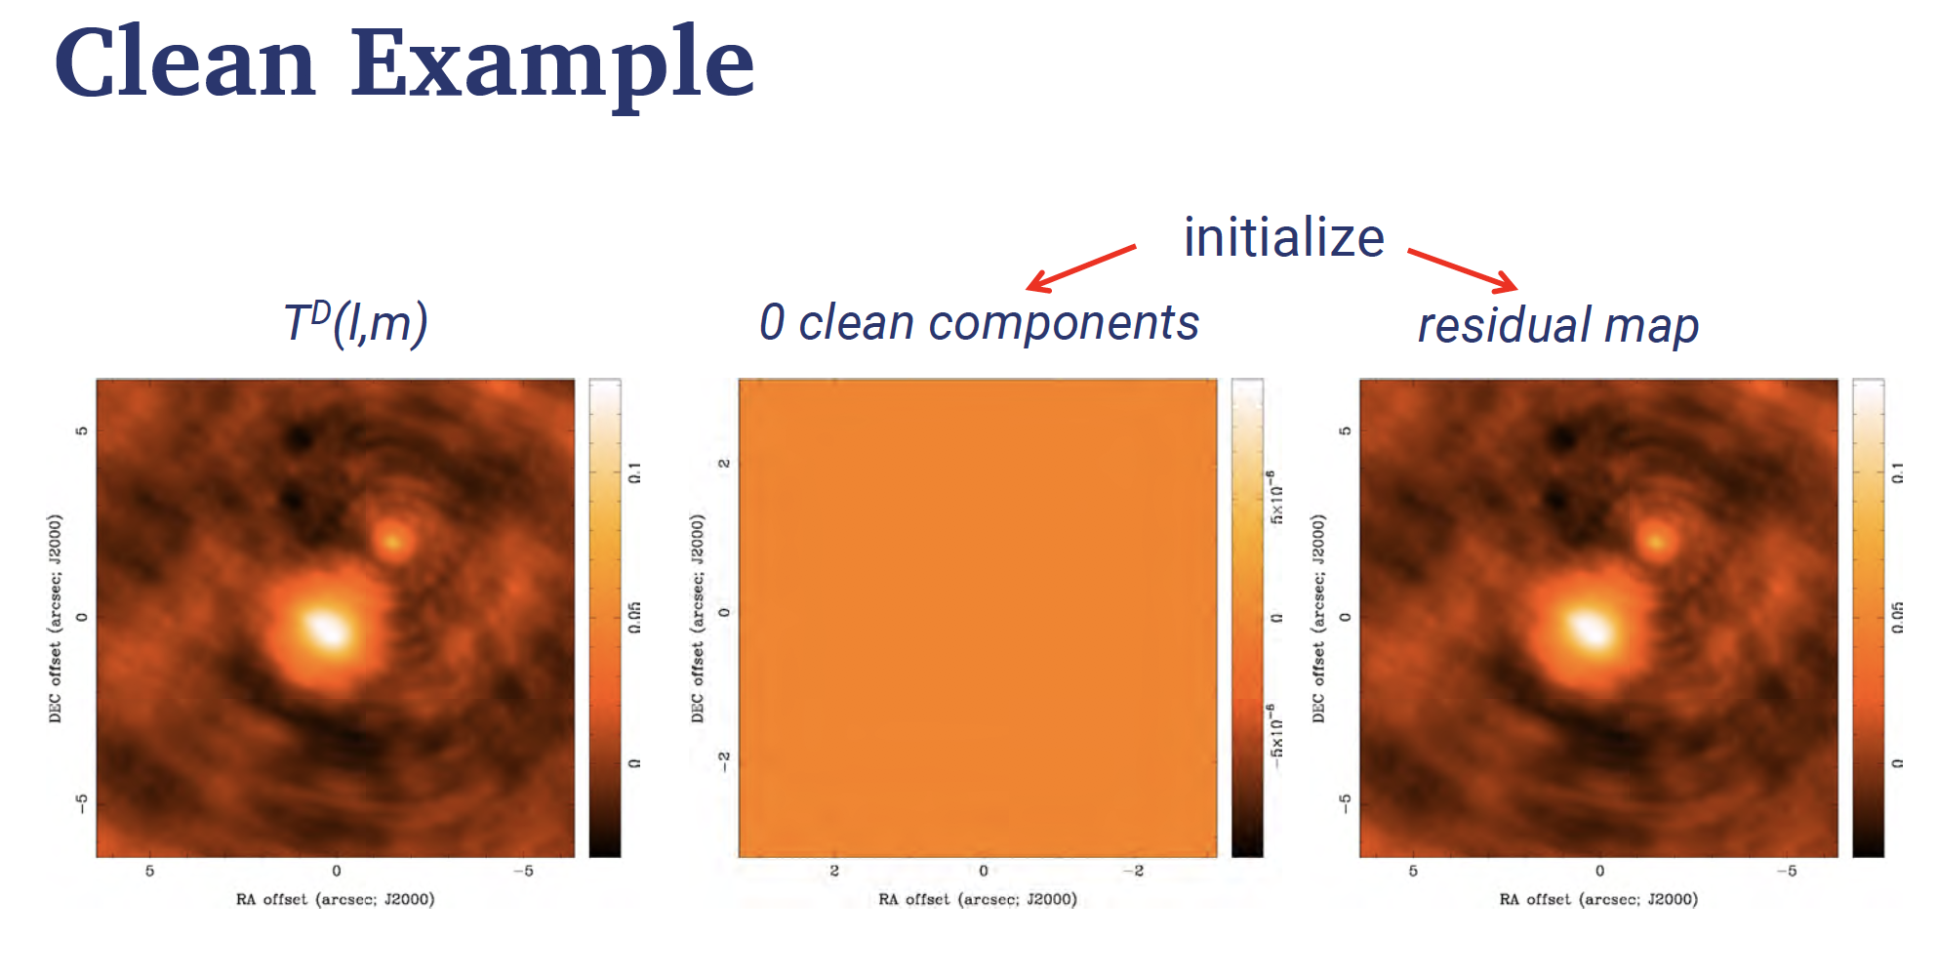

Slide 40
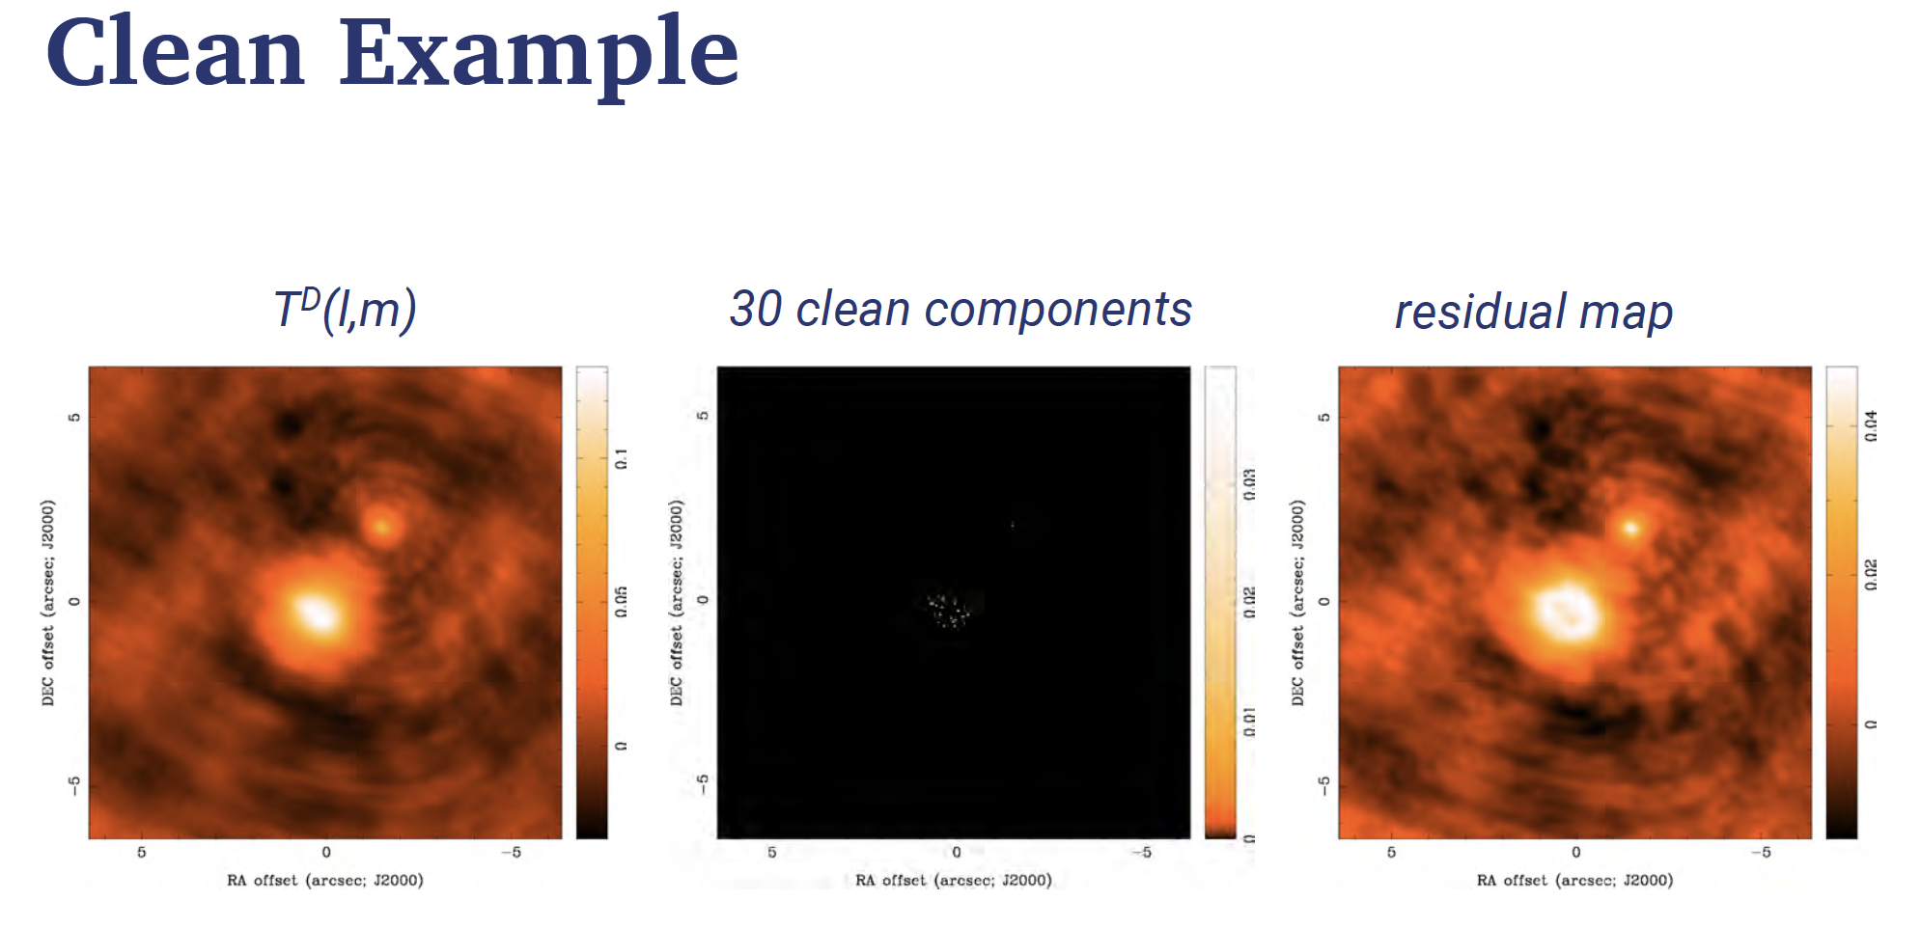

Slide 41
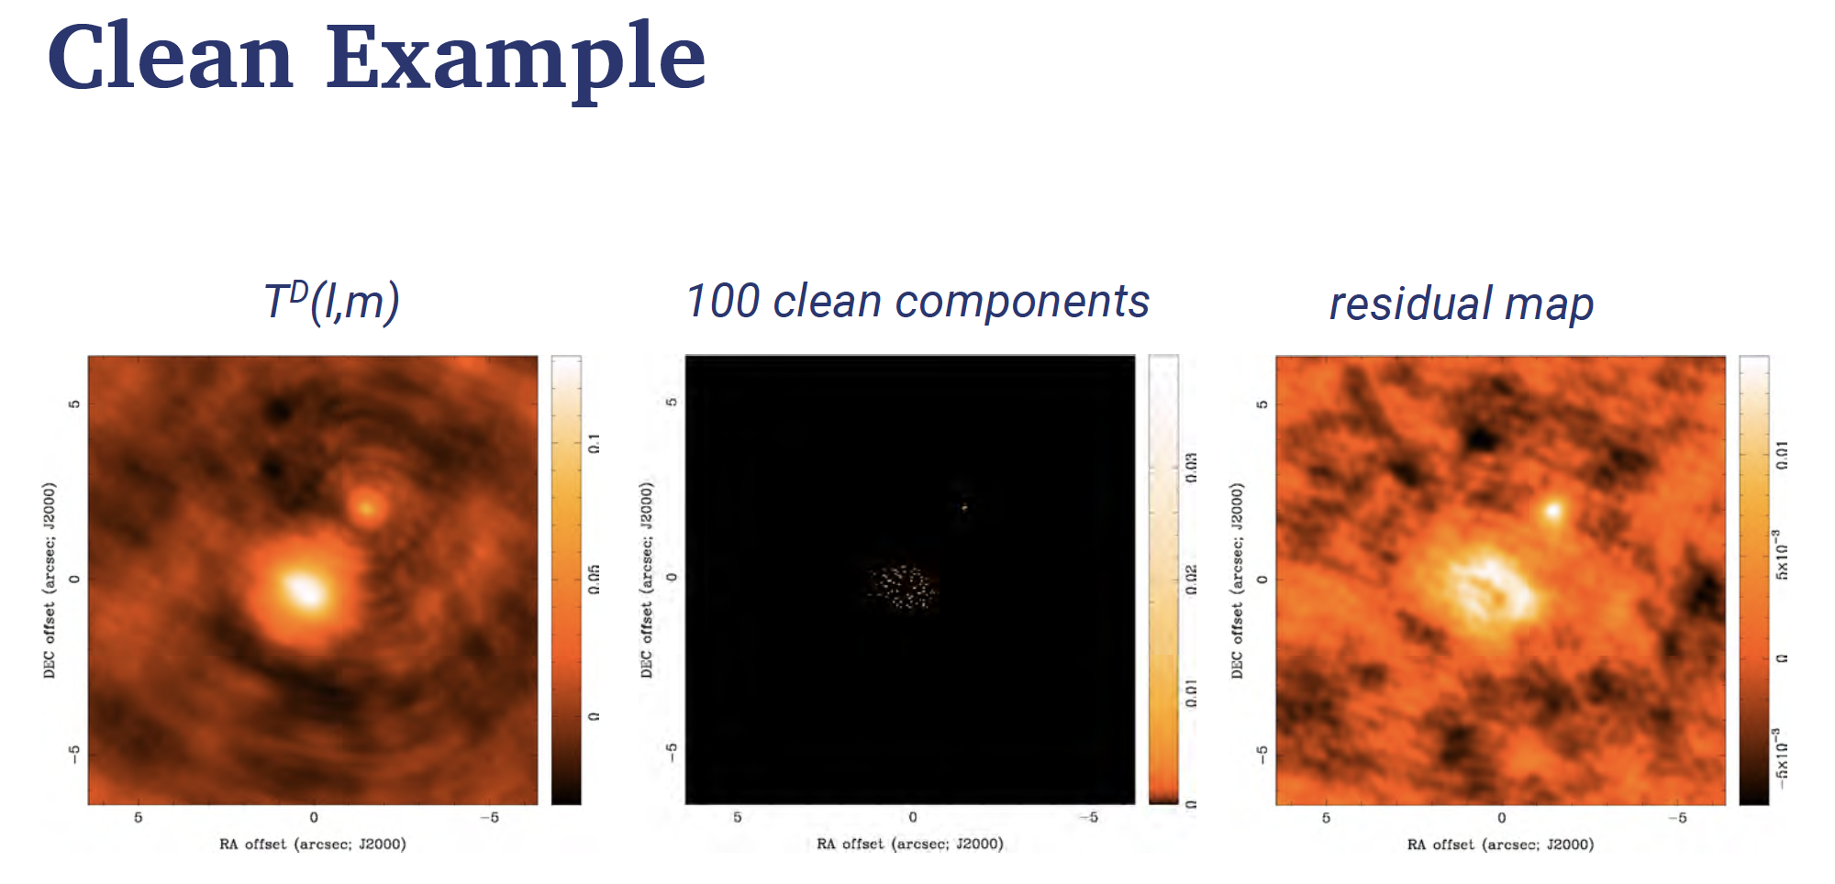

Slide 42
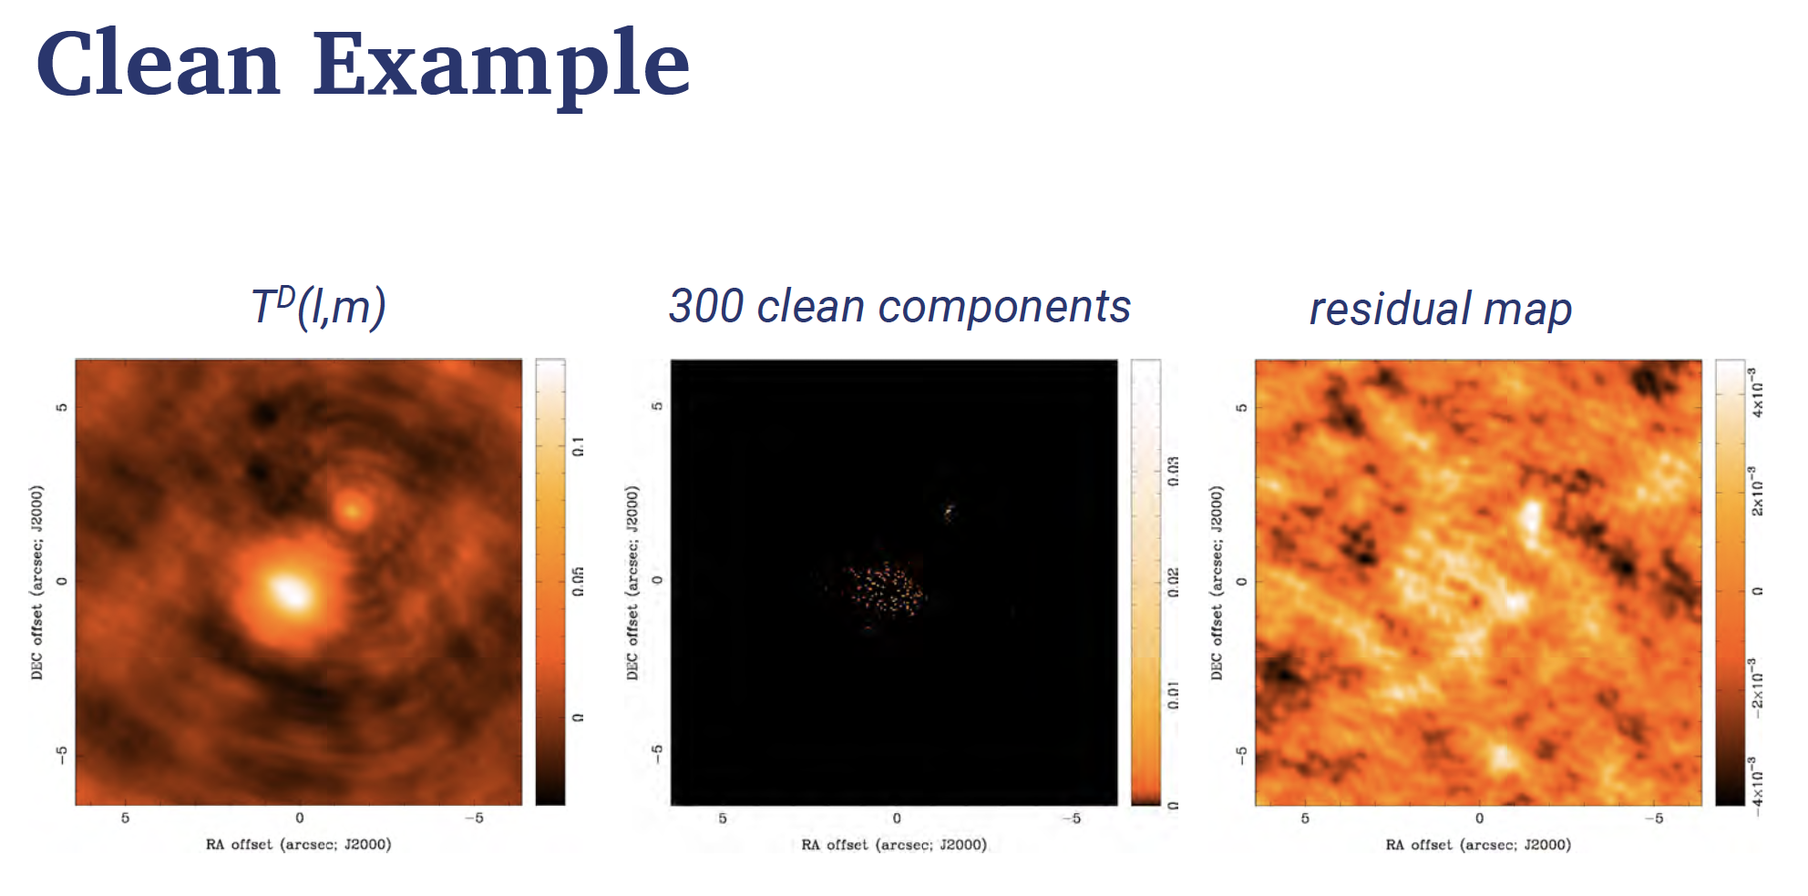

Slide 43
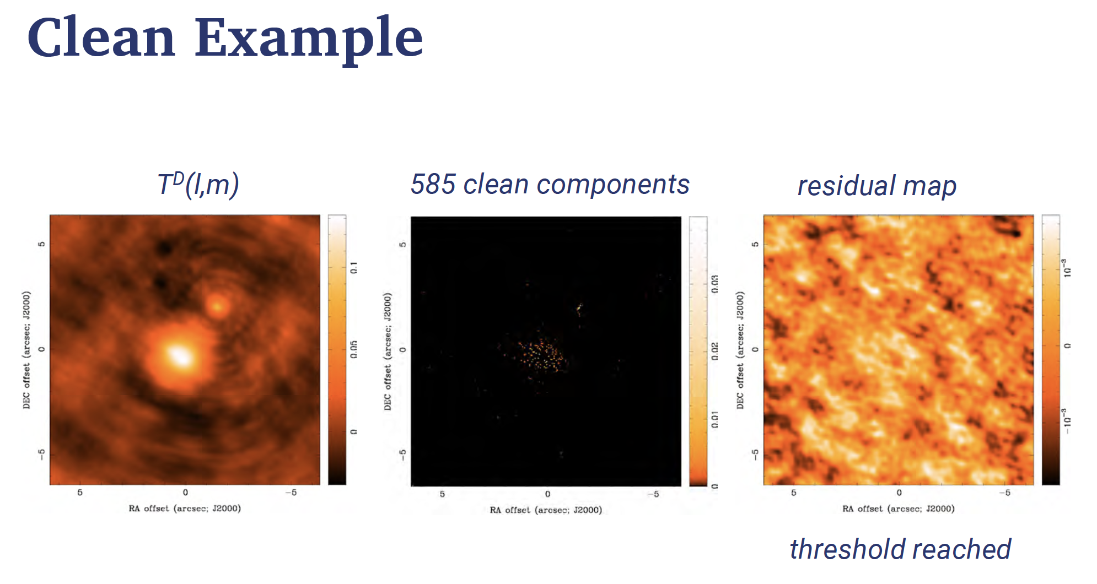

Slide 44
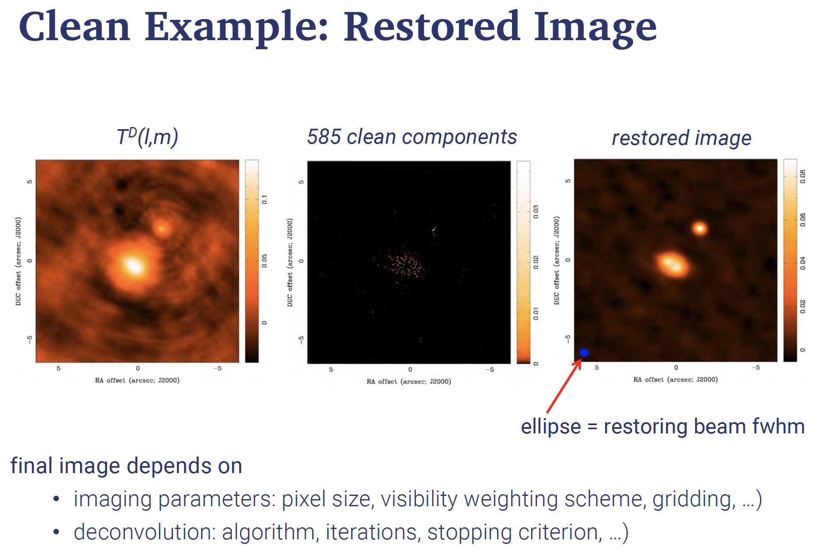

Slide 45
